Slide 1
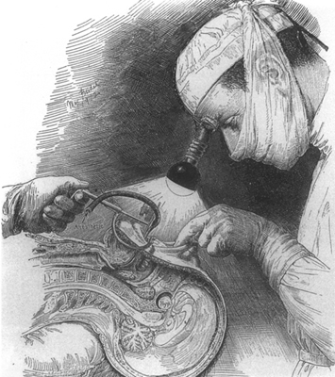
Pituitary gland: a neurosurgical prospective
Malucelli A, Bartoš R, Sameš M
Neurosurgical department, Skull base anatomy lab,
Masaryk Hospital, J.E. Purkyně University, Ústí nad Labem

Slide 2
Pituitary gland: basic anatomy
ὑπό- (hypo-) = under
φύειν (phyein) = grow

Slide 3
Pituitary gland: basic anatomy
Bilobate structure

Slide 4
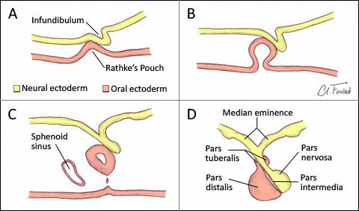
Pituitary gland: basic anatomy
Oral and neural origin

Slide 5
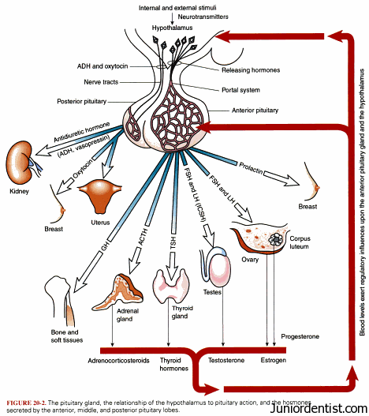
Pituitary gland: function
Adenohypophysis:
FSH
(Folliculostimulating h.)
LH
(Luteinizing h.)
ACTH
(Adrenocorticotropic h.)
TSH
(Thyroid stimulating h.)
PRL
(Prolactine)
STH
(Somatotropic h.)
Neurohypophysis:
Oxytocin
ADH
(Antidiuretic h.)

Slide 6
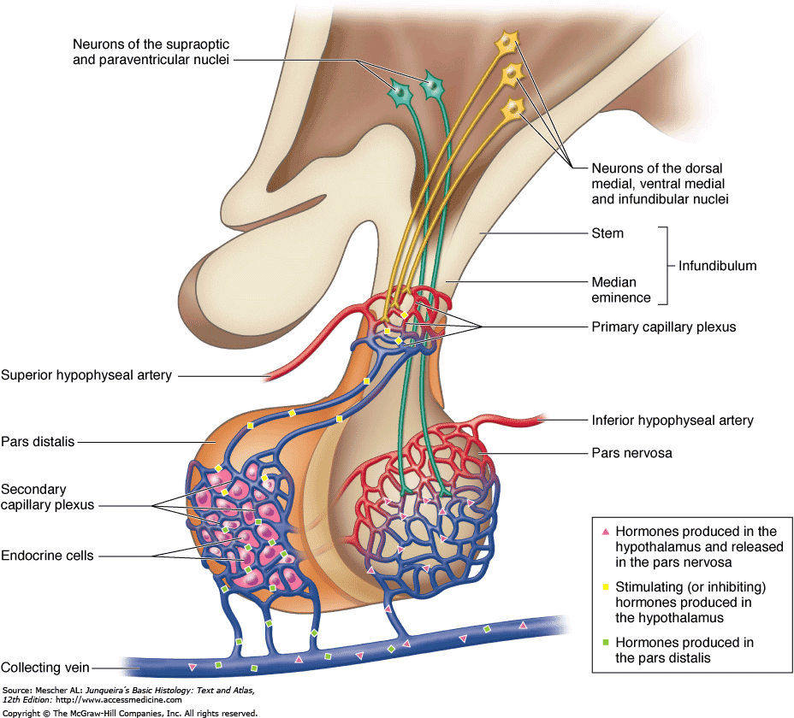
Pituitary gland: function
N. supraopticus a paraventricularis
N. arcuatus, ventromedialis, area preoptica
Tractus supraopticohypofysealis
(blue)
Tractus tuberoinfundibularis
(yellow)

Slide 7
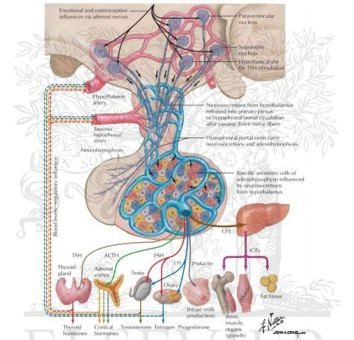
Pituitary gland: portal system

Slide 8
Pituitary gland: blood supply
Superior hypophyseal artery

Slide 9
Pituitary gland: blood supply
Superior hypophyseal artery

Slide 10
Pituitary gland: blood supply
Inferior hypophyseal artery

Slide 11
Pituitary gland: blood supply
Inferior hypophyseal artery
Truncus meningohypofisarius – Art. Bernasconi-Cassinari

Slide 12
Pituitary gland: meningeal relationships
Intradural extra-arachnoidal location

Slide 13
Pituitary gland: meningeal relationships
Intradural extra-arachnoidal location

Slide 14
Interactive section!!

Slide 15
Pituitary gland: basic anatomy
Adiuretine (ADH)

Slide 16
Male, 47 y.o.
Non functional adenoma

Slide 17
Male, 47 y.o.
Non functional adenoma

Slide 18
Direct transnasal approach

Slide 19
Direct transnasal approach

Slide 20
Direct transnasal approach

Slide 21
Direct transnasal approach

Slide 22
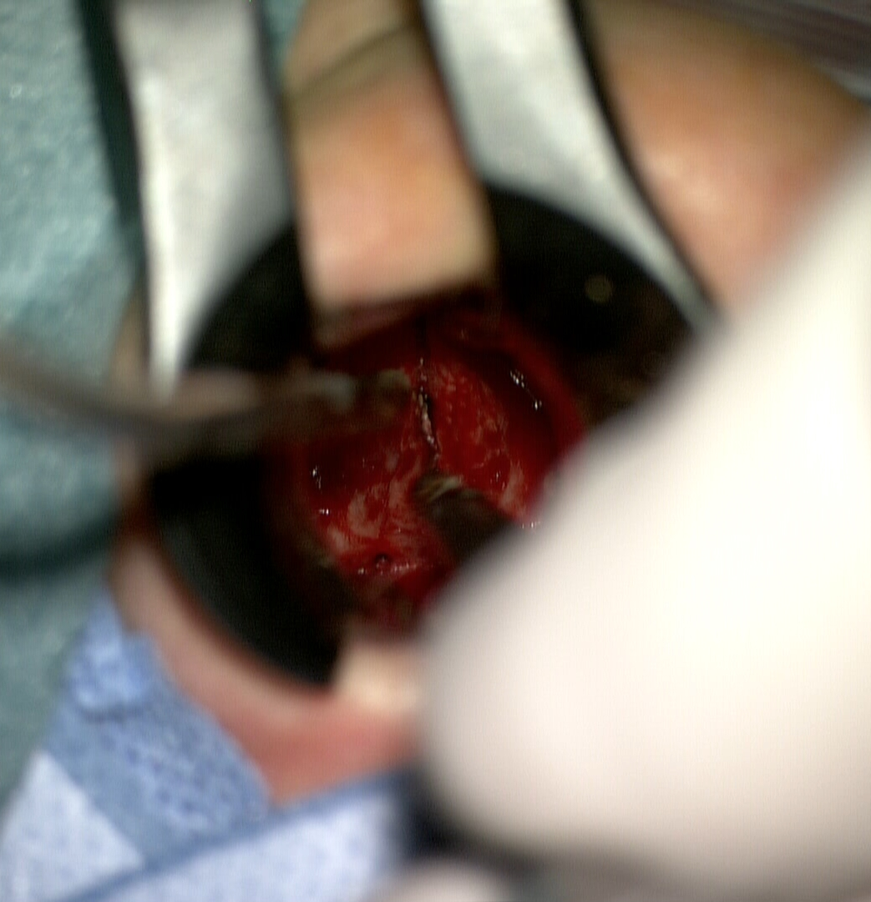
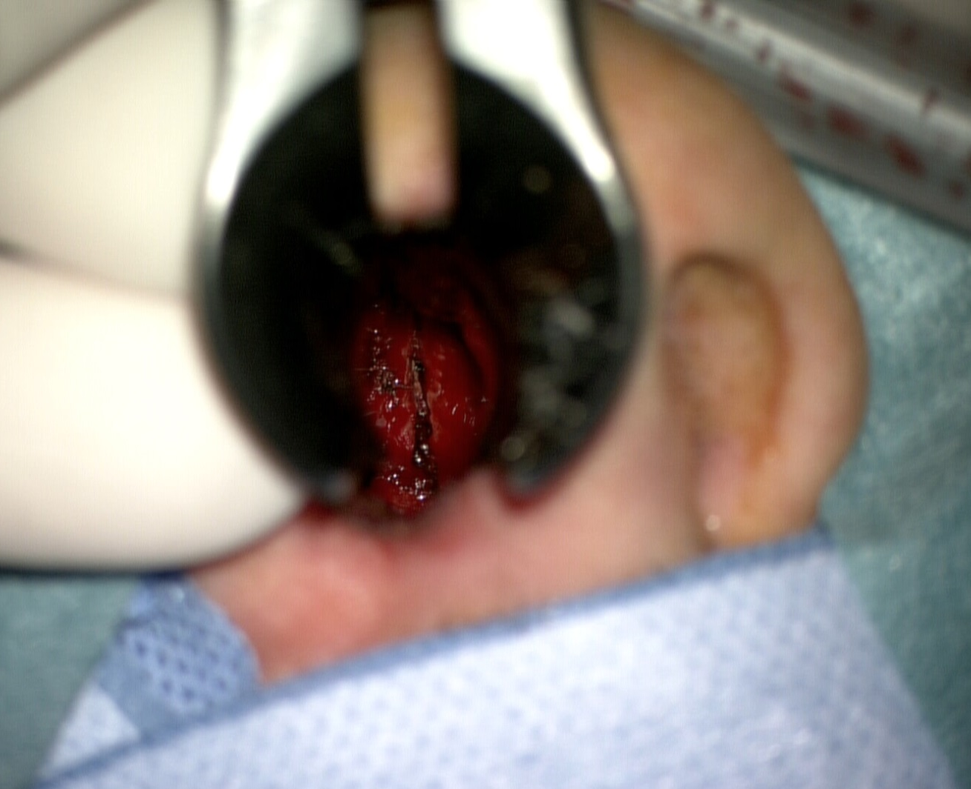
Direct transnasal approach

Slide 23
Direct transnasal approach

Slide 24
Radical resection

Slide 25
Pituitary gland: function
Adenohypophysis:
FSH
(Folliculostimulating h.)
LH
(Luteinizing h.)
ACTH
(Adrenocorticotropic h.)
TSH
(Thyroid stimulating h.)
PRL
(Prolactine)
STH
(Somatotropic h.)
Neurohypophysis:
Oxytocin
ADH
(Antidiuretic h.)

Slide 26
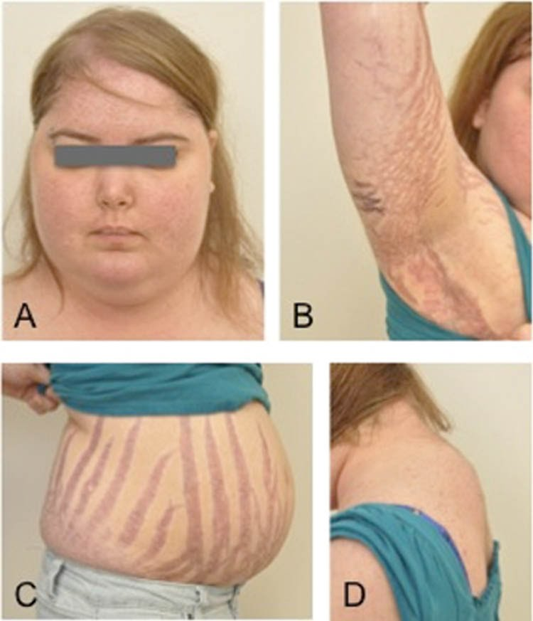
ACTH Cushing‘s syndrome

Slide 27
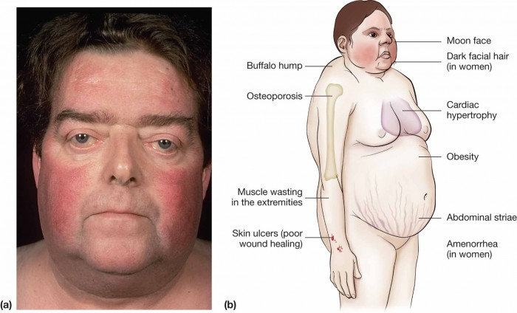
Pituitary gland: function
ACTH – Cushing‘s syndrome

Slide 28
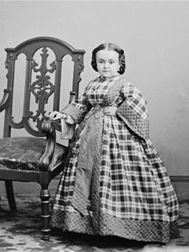
Pituitary gland: function
STH – dwarfism in children, obesity and weakness in adults

Slide 29
Pituitary gland: function
TSH
Hyperthyroidism

Slide 30
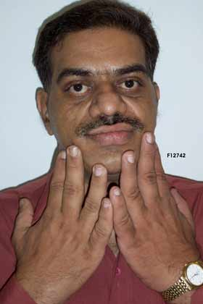
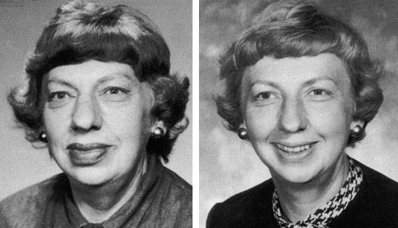
Pituitary gland: function
STH
Acromegaly

Slide 31
Pituitary gland: function
FSH
PRL

Slide 32
Pituitary gland: function
ADH
Diabetes insipidus

Slide 33
Male, 70 y.o., acute palsy III. and VI. c.n., polyuria, hypernatriemia
Apoplexy

Slide 34
Resection (day 1)

Slide 35
Day 30

Slide 36
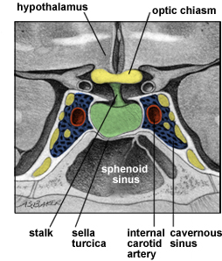
Pituitary gland: topography

Slide 37
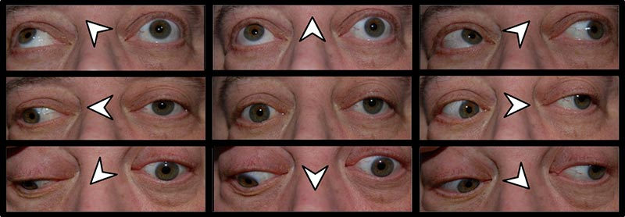
Cranial nerve palsy
Left III. c.n. palsy
Oculomotorius

Slide 38
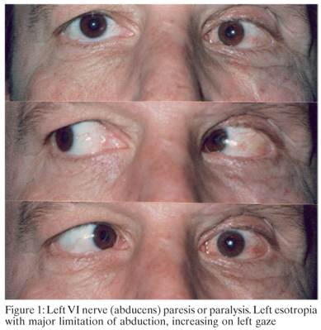
Cranial nerve palsy
Left VI. c.n. palsy
Abducens

Slide 39
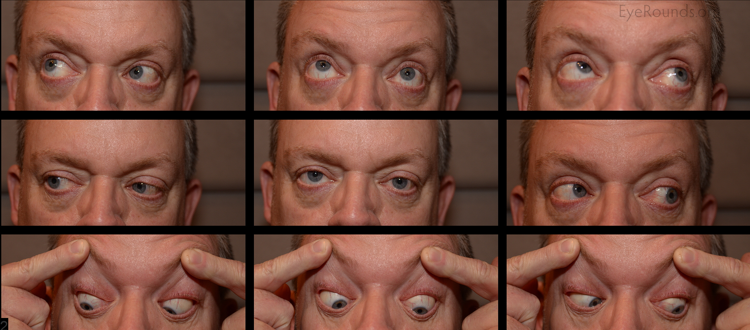
Cranial nerve palsy
Left IV. c.n. palsy
Troclearis

Slide 40
Female, 67 y.o., progressive vision loss

Slide 41
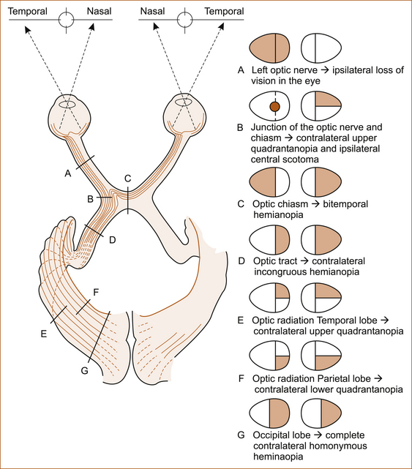
Pituitary gland tumour: vision loss

Slide 42
Subtotal resection

Slide 43
MR 6 months after surgery, recurrence, further vision loss

Slide 44
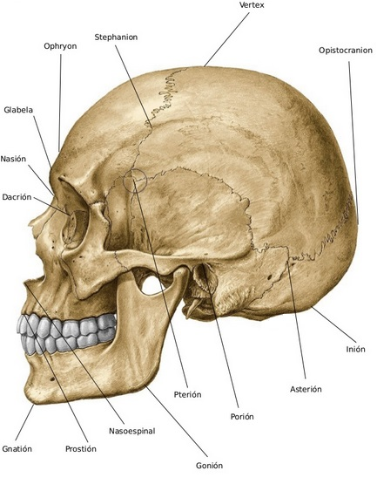
Pterional approach

Slide 45
Pterional approach

Slide 46
Pterional approach

Slide 47
Pterional approach

Slide 48
Pterional approach

Slide 49
MR after 6 months, small remnant, right eye blindness, left eye temporal hemianopia

Slide 50
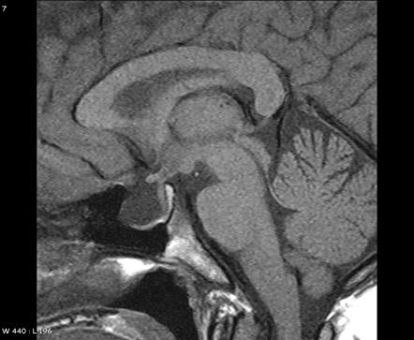
Empty sella syndrome

Slide 51
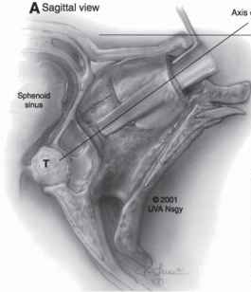
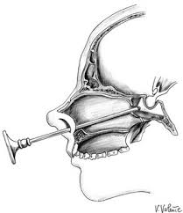
Microsurgery x endoscopy pituitary surgery
Schloffer 1907
Cushing 1912
Griffith Direct transnasal 1987
Jankowski Endoscopic surgery 1992

Slide 52
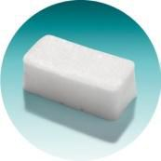
Dural and arachnoidal reconstruction
Tachosil
Fascia lata
Fat
Tissucol
Nasopore

Slide 53
Male, 43 y.o.

Slide 54
Pituitary haemorragic apoplexy

Slide 55
Pterionall approach

Slide 56
MR day 1

Slide 57
Transcortical transventricular approach

Slide 58
Transcortical transventricular approach

Slide 59
MR day 3

Slide 60
alberto.malucelli@kzcr.eu

Slide 61
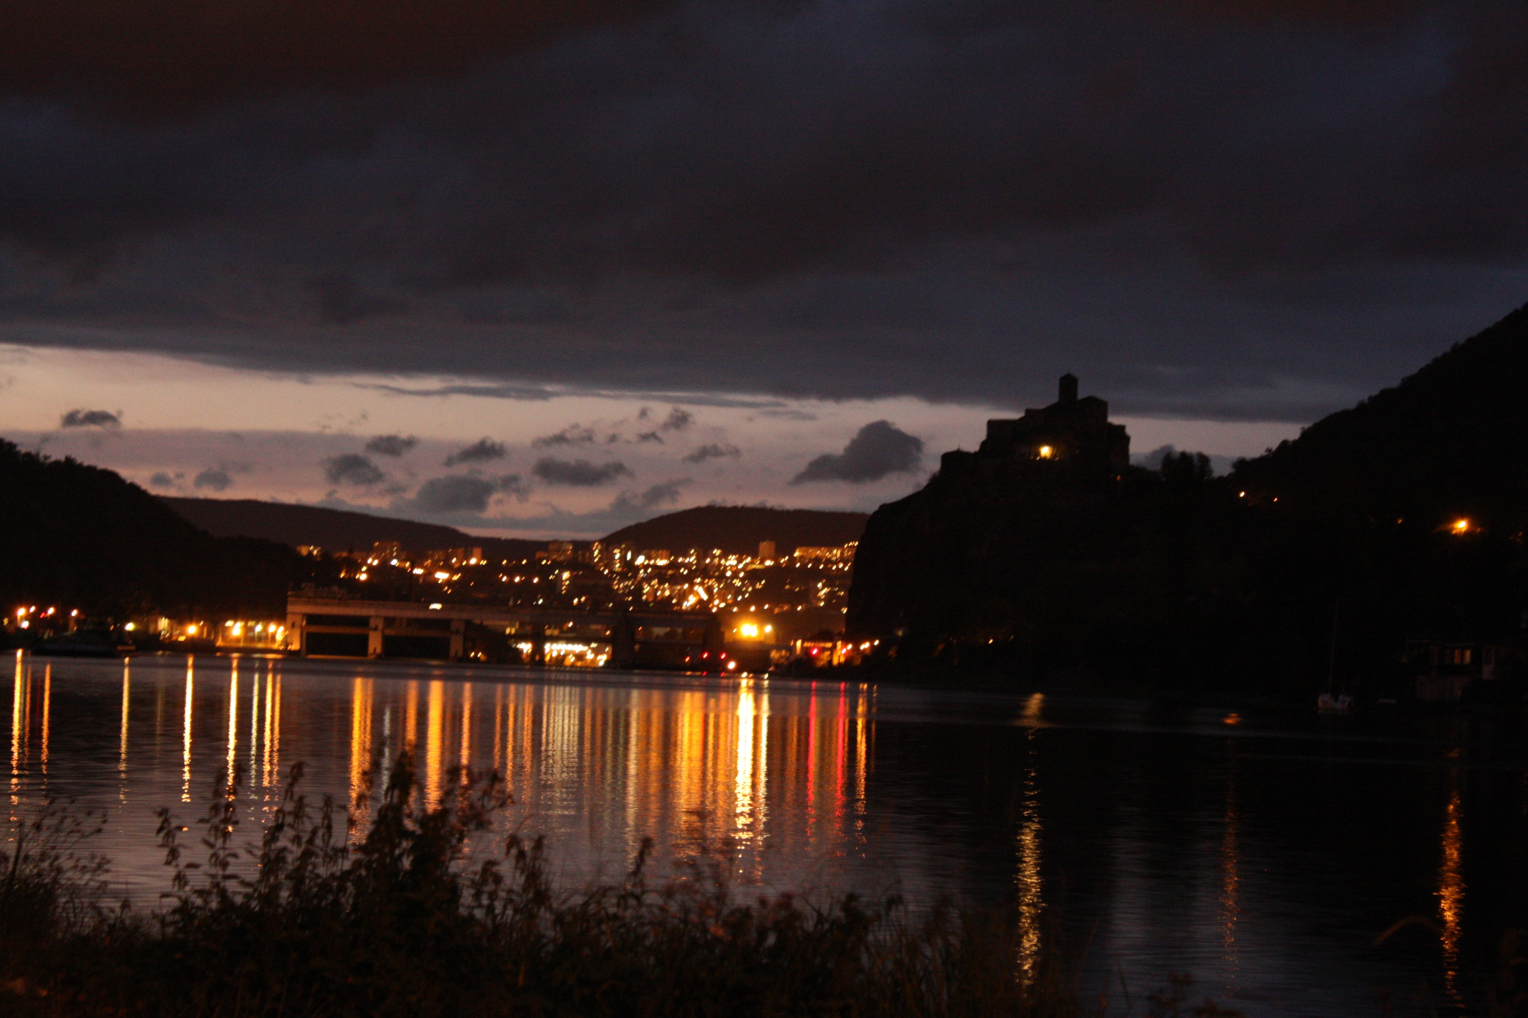
GRAZIE PER L‘ATTENZIONE!

