Slide 1
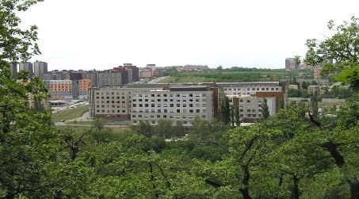

Endoscopy of the GI tract: the new surgical specialty
Assoc. Prof. Jan Martínek
IKEM

Slide 2
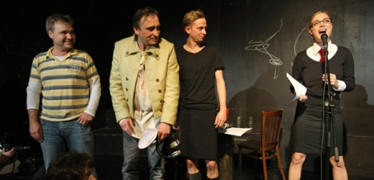

Slide 3

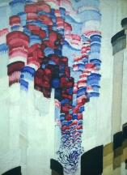
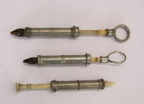
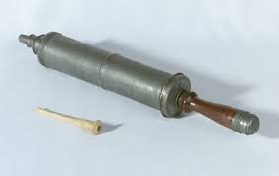
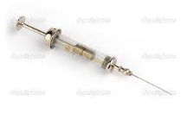
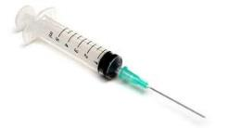
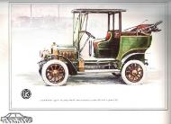
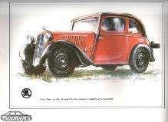
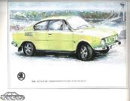
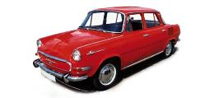


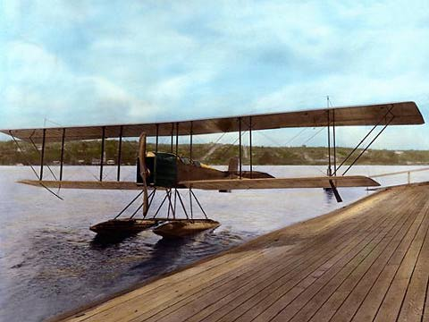
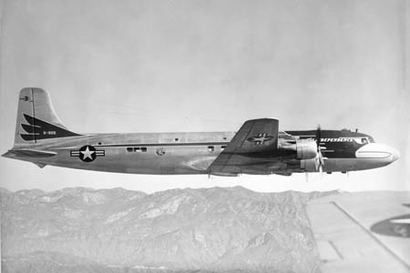
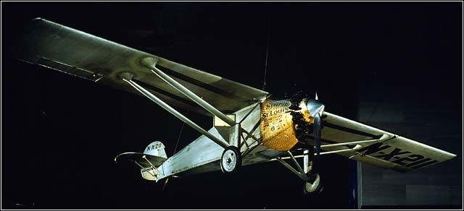

Slide 4
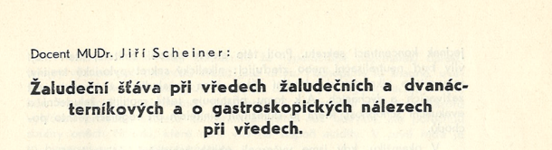
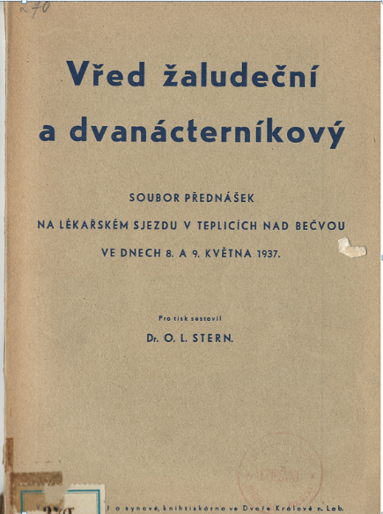
Gastroscopy ceased to be a dangerous technique, although it is still to be used only by select few. It is not usable as a practical diagnostic tool. … it shall stay forever restricted to clinics and institute, and even there it will be limited to a narrow circle of the experts...

Slide 5
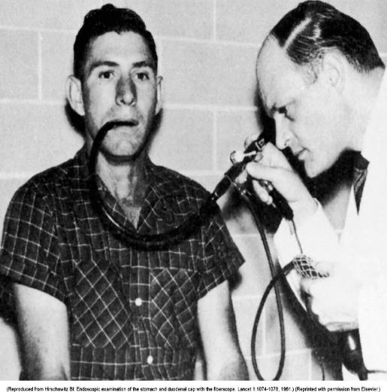
FLEXIBLE ENDOSCOPY ?
Dr. B. Hirschowitz
1957 – 1961
- Optics on the side of the instrument

Slide 6
ENDOSCOPY
DIAGNOSTICS
ENDOSCOPIC
SURGERY
ENDOTHERAPY
Reflux esofagitis
ulcers, tumours
Inflamation…
Haemostasis
Polypectomy
Dilation
ERCP…
Submucosal endoscopy
Pancreas necrosis
„Full thickness resection“

Slide 7
ENDOSCOPIC TREATMENT OF EARLY NEOPLASIA

Slide 8
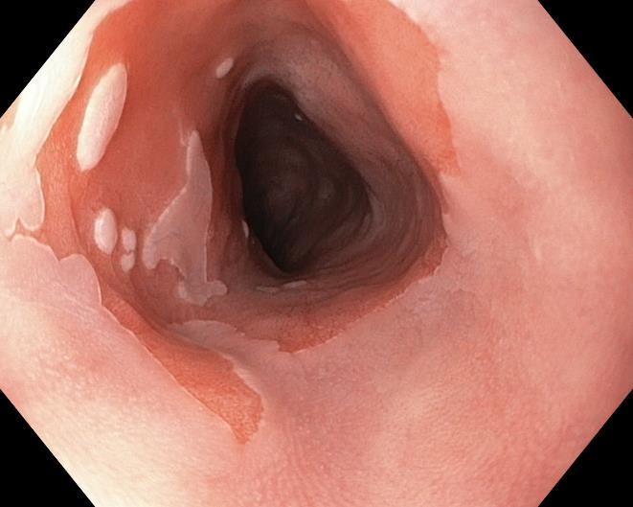
BARRETT‘S ESOPHAGUS = PRECANCEROUS CONDITION

Slide 9
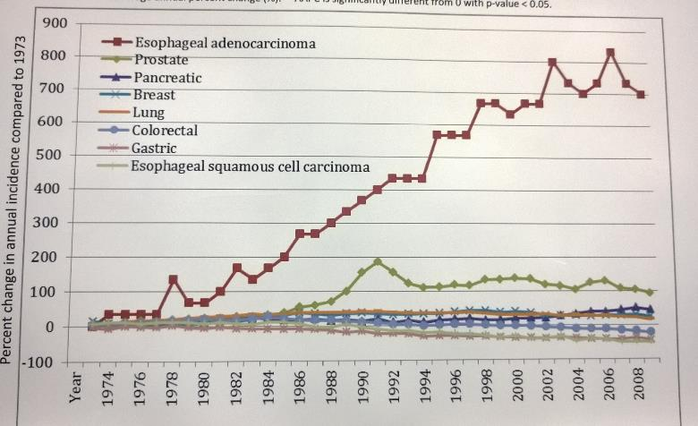
INCIDENCE OF ESOPHAGEAL ADENOCARCINOMA
Gamboa AM, DDW, 2014

Slide 10
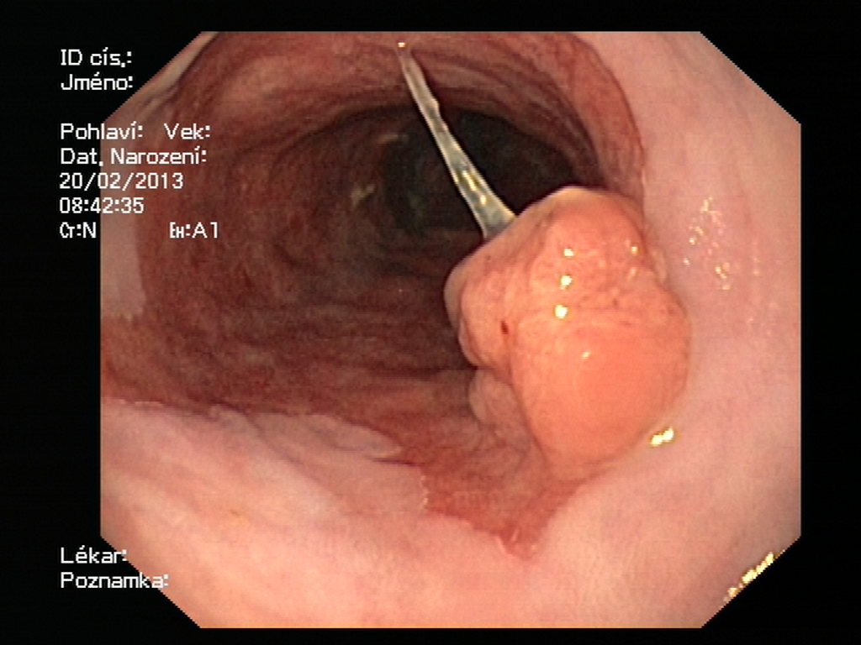

Slide 11
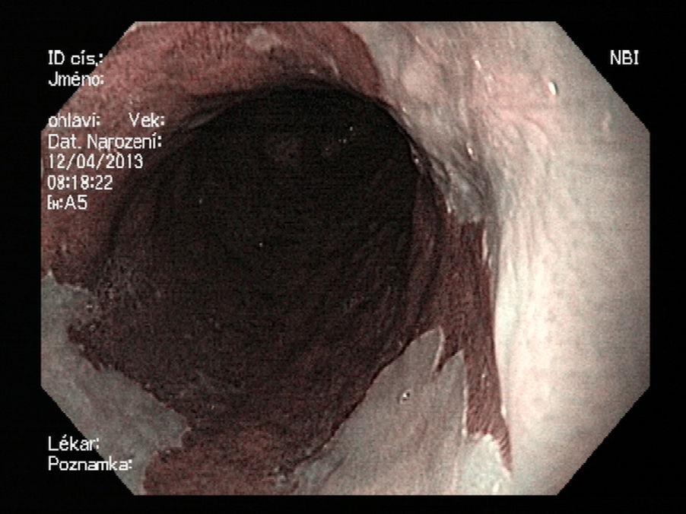

Slide 12
PARADIGM SHIFT IN ESOPHAGEAL CANCER THERAPY
PRESENT
PAST
HGD, EARLY CANCER (T1a, T1b)
HGD, CARCINOMA
ENDOSCOPIC THERAPY
STAGING
SURGERY
SURGERY
OR ENDOSCOPIC
THERAPY

Slide 13
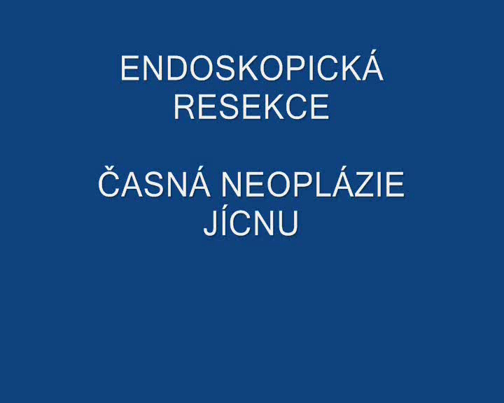

Slide 14
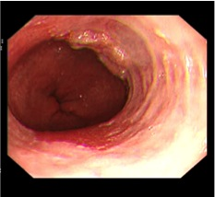
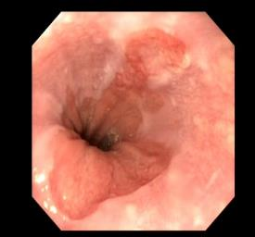
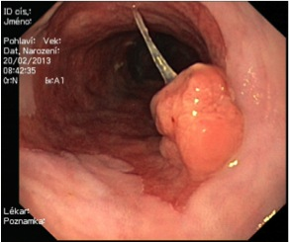
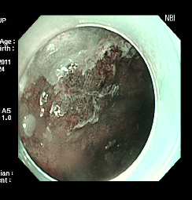
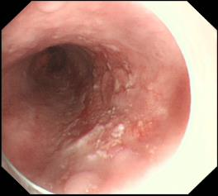
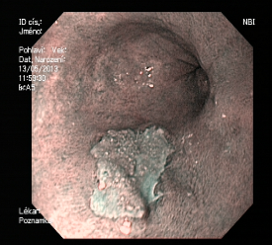
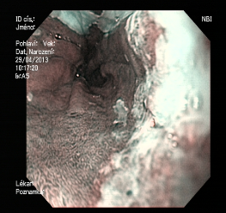
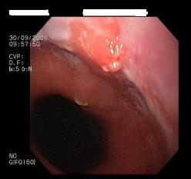
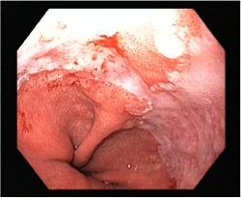
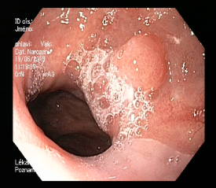
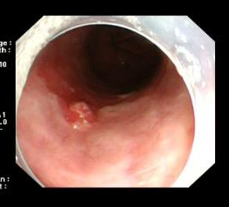
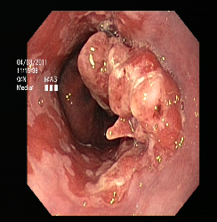

Slide 15
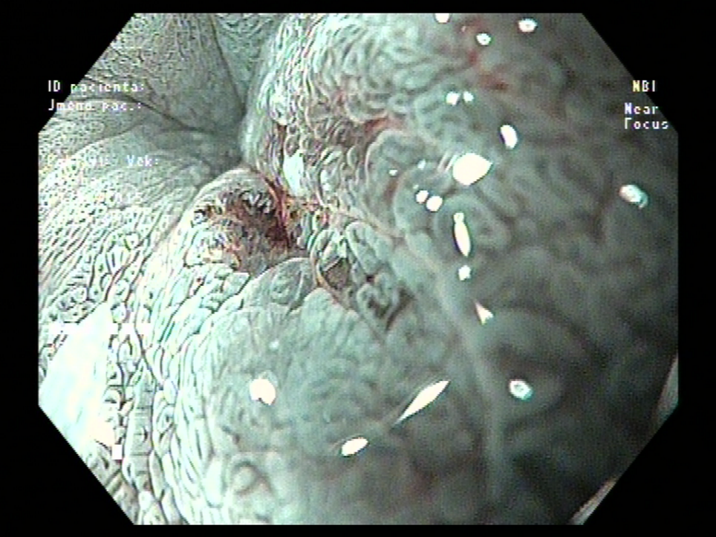

Slide 16
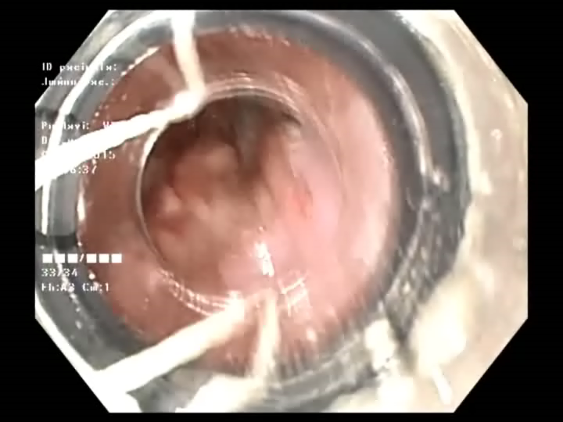
ENDOSKOPIC RESECTION

Slide 17
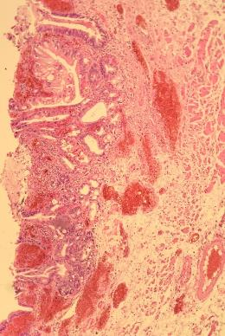
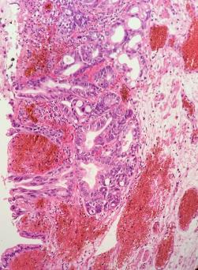
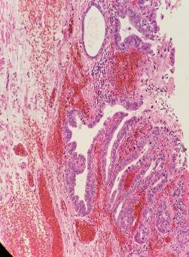
EARLY CARCINOMA, CURE
24x12x1-2 mm
Staging: pT1a (m3), pNx, pMx,
G 1, TCD 0, A 0, L 0,
R 0 (VM0, HM0)

Slide 18
5-YEAR MORTALITY IN ENDOSCOPICALLY-TREATED PATIENTS IS SMALLER THAN 30-DAY MORTALITY AFTER ESOPHAGEAL RESECTION

Slide 19
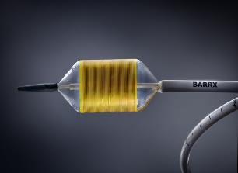
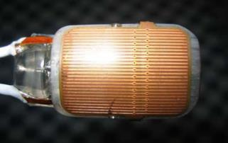
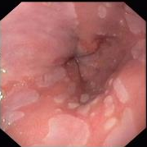
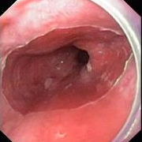
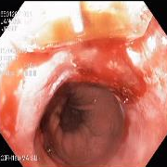
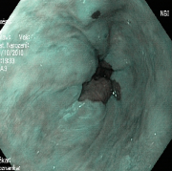
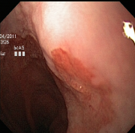
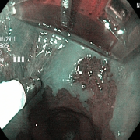
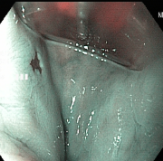
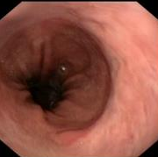
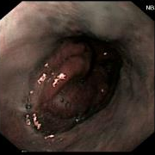

RADIOFREQUENCY ABLATION

Slide 20


Slide 21




2x endoscopic resection
2x radiofrequency ablation
21

Slide 22

ENDOSKOPIC SUBMUCOSAL DISSECTION

Slide 23





Slide 24
SUBMUCOSAL ENDOSCOPY

Slide 25

SUBMUCOSA

Slide 26


Upper esophageal sphincter
GI Motility online (May 2006) | doi:10.1038/gimo6
Cartilage
(thyroid, cricoid)
Muscles
(cricopharyngeal,
thyropharyngeal,
Cervical esophagus)
Bone
(hyoid bone)

Slide 27

Esophageal musculature
GI Motility online (May 2006) | doi:10.1038/gimo6
1/3: striated
2/3: smooth

Slide 28


Lower esophageal sphincter
Angle of His

Slide 29
Lower esophageal sphincter
FUNCTION (+): ACHALASIA
FUNCTION (-): GE REFLUX (REFLUX DISEASE OF THE ESOPHAGUS)

Slide 30


ACHALASIA
1672 – Sir Thomas Willis – description
1913 – Ernest Heller – myotomy
1927 – Arthur Hurst – name
Treatment
Dilation (whalebone with sea sponge)
Myotomy
Botulotoxin

Slide 31

ACHALASIA TREATMENT, 1964
Mařatka, 1964

Slide 32


Slide 33

Per Oral Endoscopic Myotomy
August 2008 – first POEM in human
Inoue H, Minami H, Kobayashi Y, et al. Peroral endoscopic myotomy (POEM) for esophageal achalasia. Endoscopy 2010;42:265-271

Slide 34




First POEM in CR – December 2012

Slide 35


Slide 36


Slide 37


Slide 38

POEM IKEM – success rates
200 POEM procedures
ES ˂ 3

Slide 39



Slide 40


Slide 41

HRM with impedance (HRIM, HRM-Z)
„dysphagia lusoria“
Vascular srtifact from a.lusoria

Slide 42


Slide 43
GASTROPARESIS
Delayed stomach emptying without proven obstruction
  Idiopatic
  Diabetes mellitus
  After stomach surgery
Prevalence 0.2% (in CR up to 20 000 pacients)

Slide 44








FIRST ENDOSCOPIC PYLOROMYOTOMY
(G-POEM) IN IKEM, 9.11.2005

Slide 45


Slide 46


