Slide 1



Clinical anatomy
Imaging in Cardiology
Radka Kočková

Slide 2
History of US imaging
Dussik KT in Australia in 1941
US brain imaging
Keidel WD in Germany in 1950
US heart imaging
J. R. T. C. RoelandtEur J Echocardiography (2000) 1, 8–11
www.ob-ultrasound.net/dusikbio.html

Slide 3
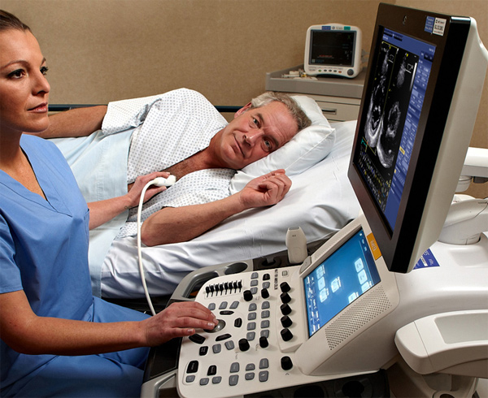
Modern US scanners

Slide 4
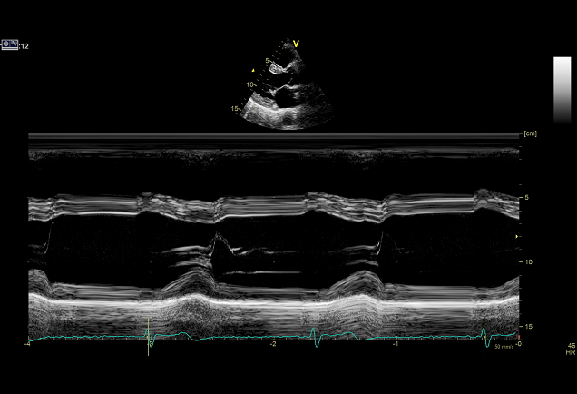
M-mode US imaging
1953 – Edler a Hertz 2017 - IKEM

Slide 5
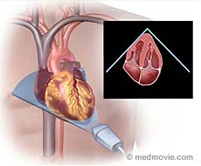
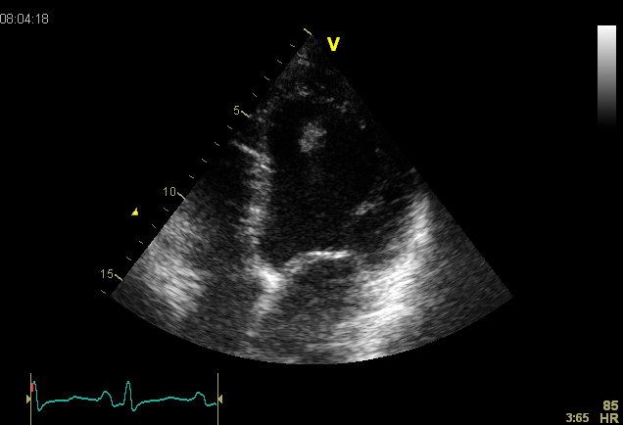
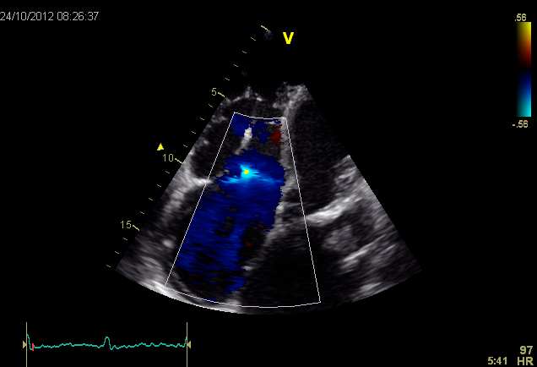
2D (2 dimensional imaging)
TTE (transthoracic echocardiography)
2D – TTE Colour doppler TEE

Slide 6
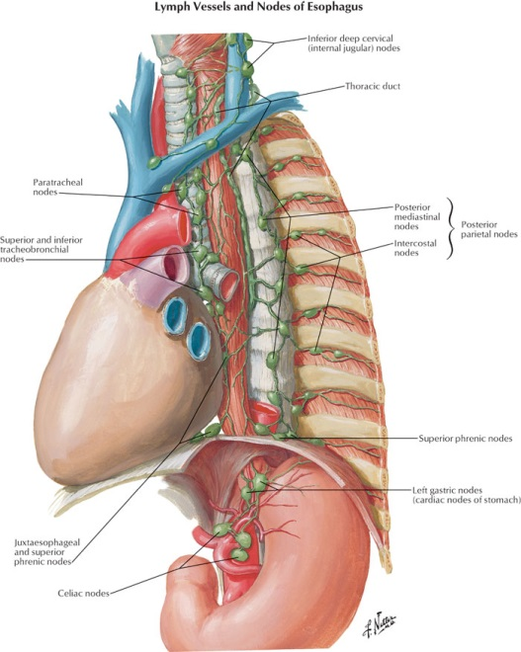
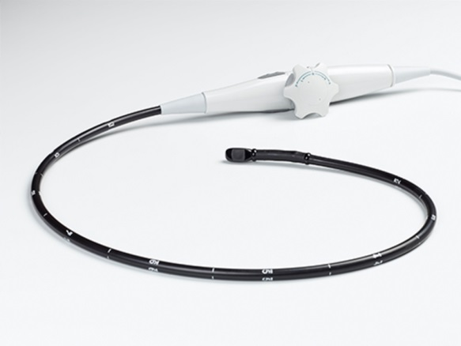
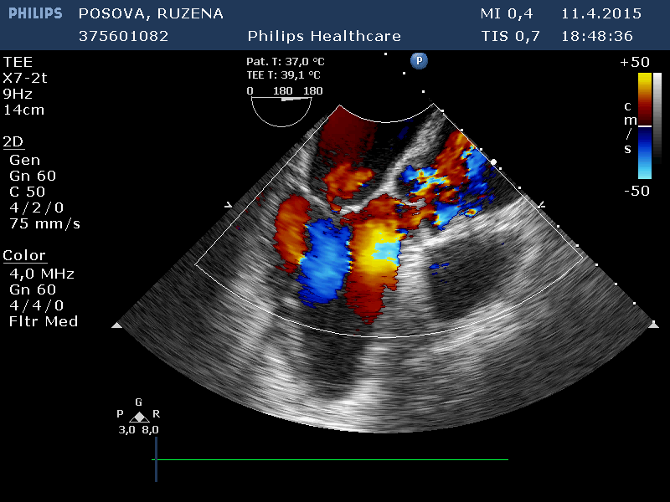
TEE – transesophageal echocardiography

Slide 7
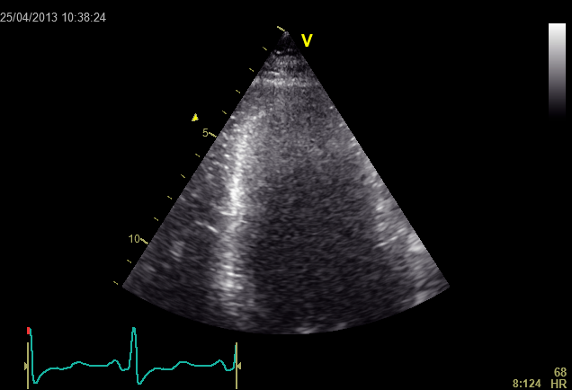
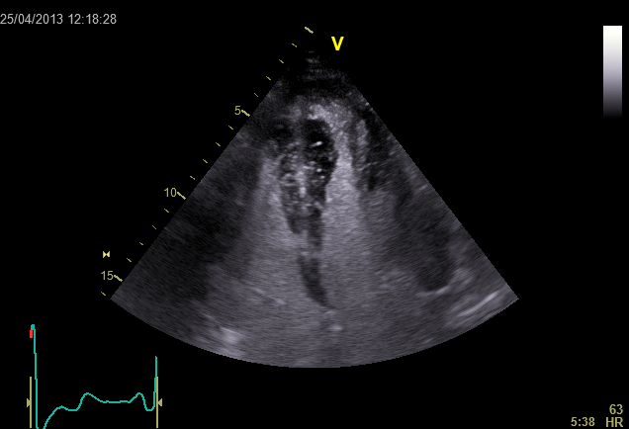
Contrast US imaging
Gramiak R and Shah PM discovered in 1968
Native TTE Contrast TTE

Slide 8
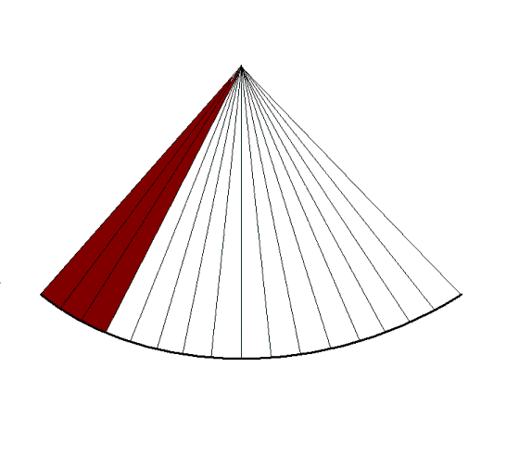
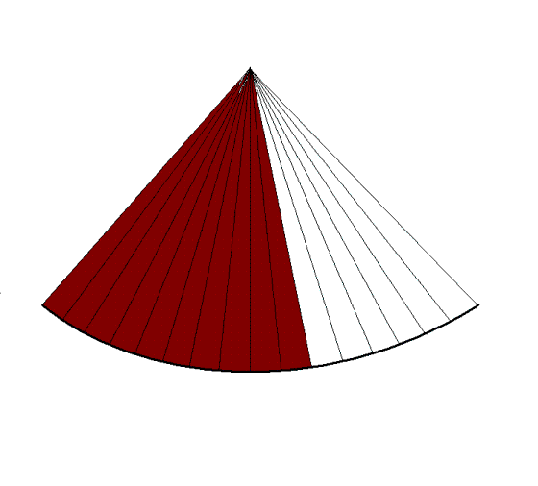
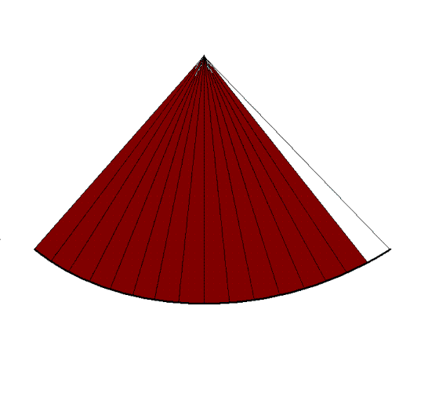
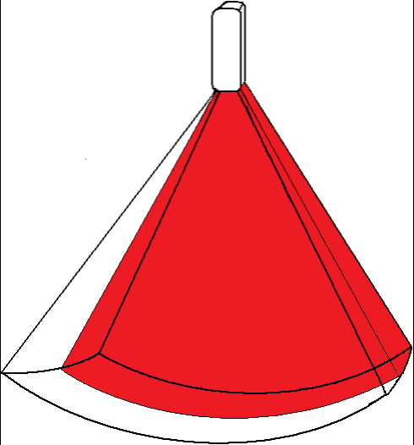
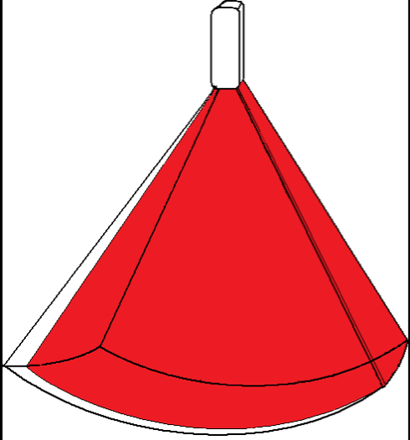
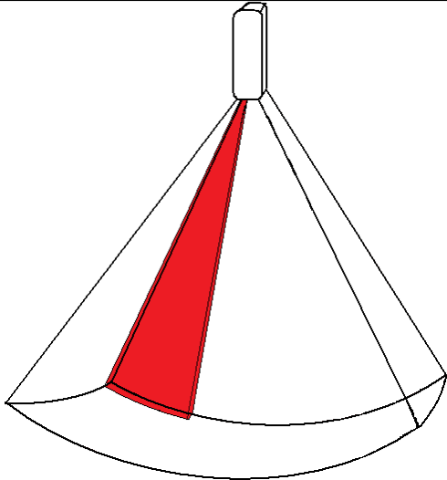
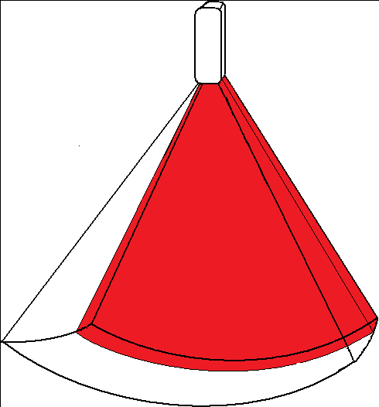
3D ECHO
1973 – Tom Brown
Rapid PC and US probe technology development (3000 piezoelectric crystals in matrix)
2D ECHO – 64 rows
3D ECHO - 64 x 64 = 4096 rows
http://folk.ntnu.no

Slide 9
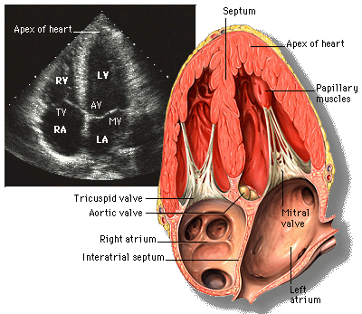
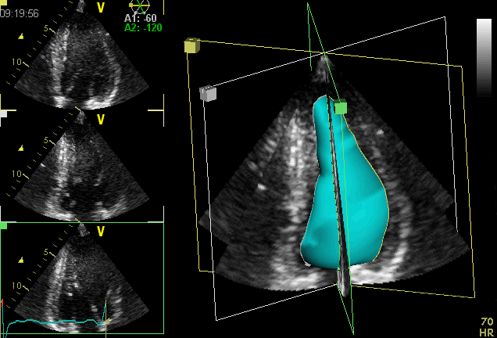
3D – LV volumes and systolic function
Dr Vencatesan MD

Slide 10
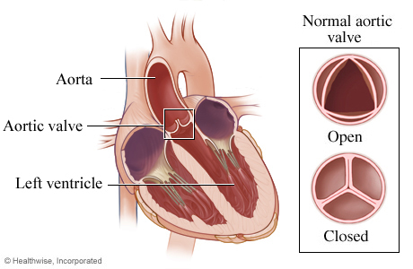
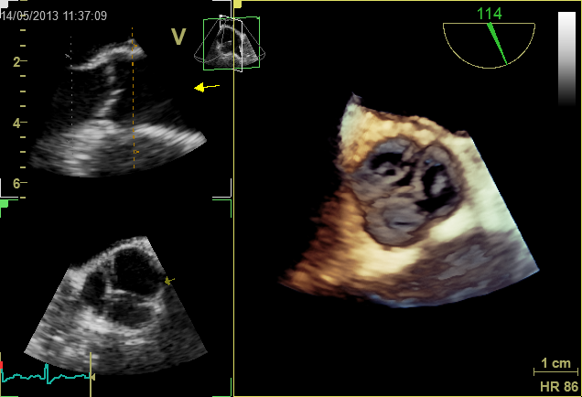
3D – aortic valve
http://www.webmd.com/heart-disease/heart-failure/aortic-valve

Slide 11
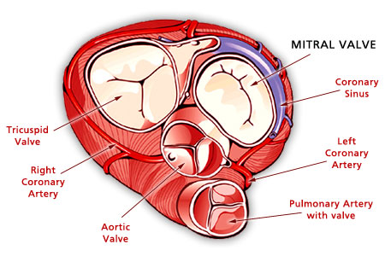
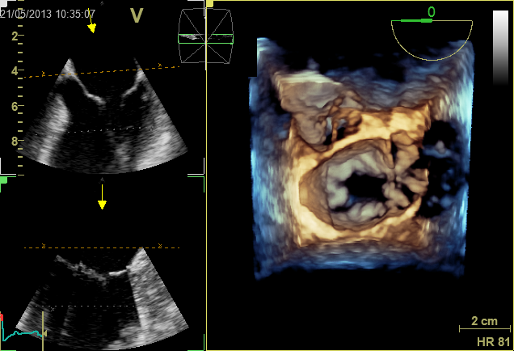
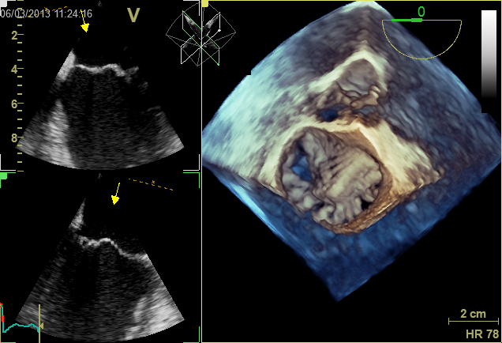
3D mitral valve
Normal mitral valve Mitral valve prolaps

Slide 12
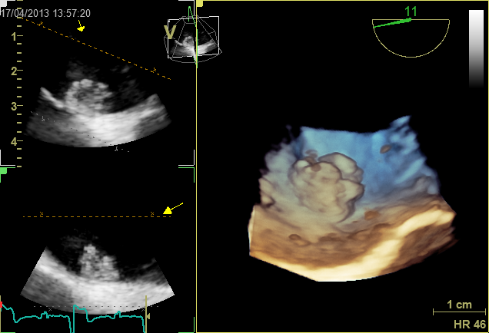
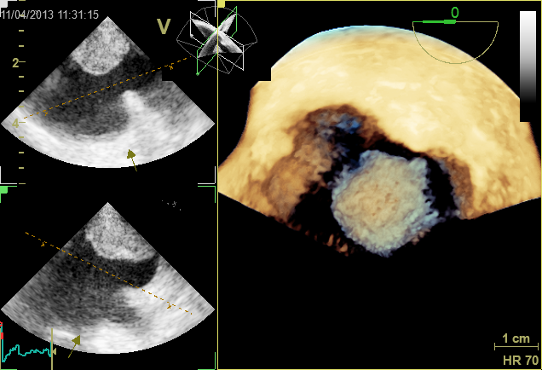
3D – intracardiac mass
Myxoma in fossa ovalis Left atrial thrombus

Slide 13
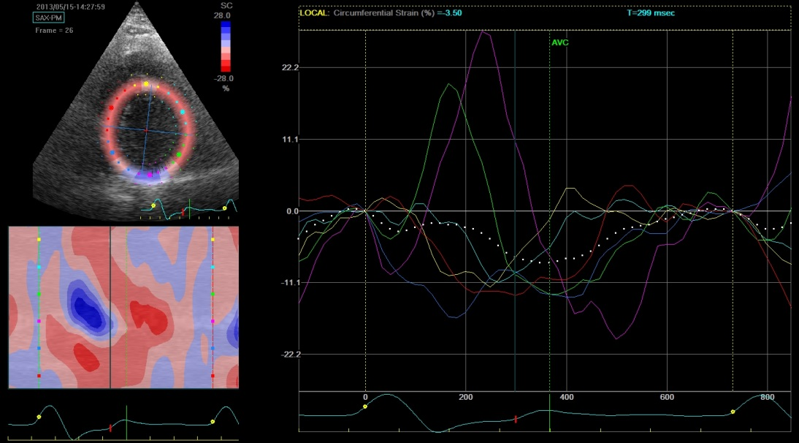
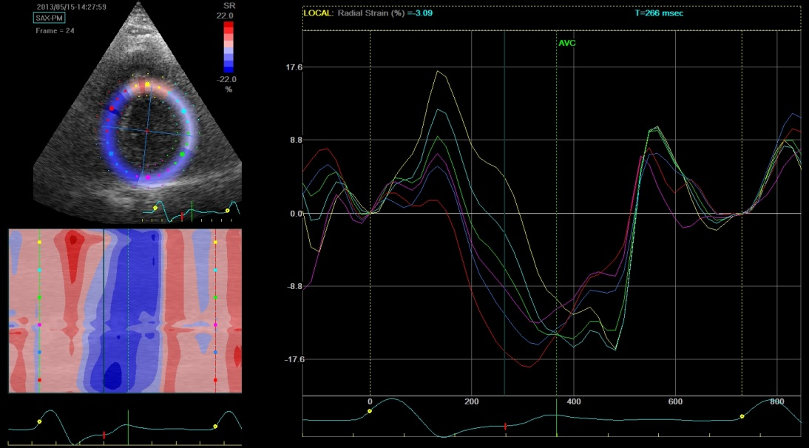
Speckle tracking
Circumferential strain Radial strain

Slide 14
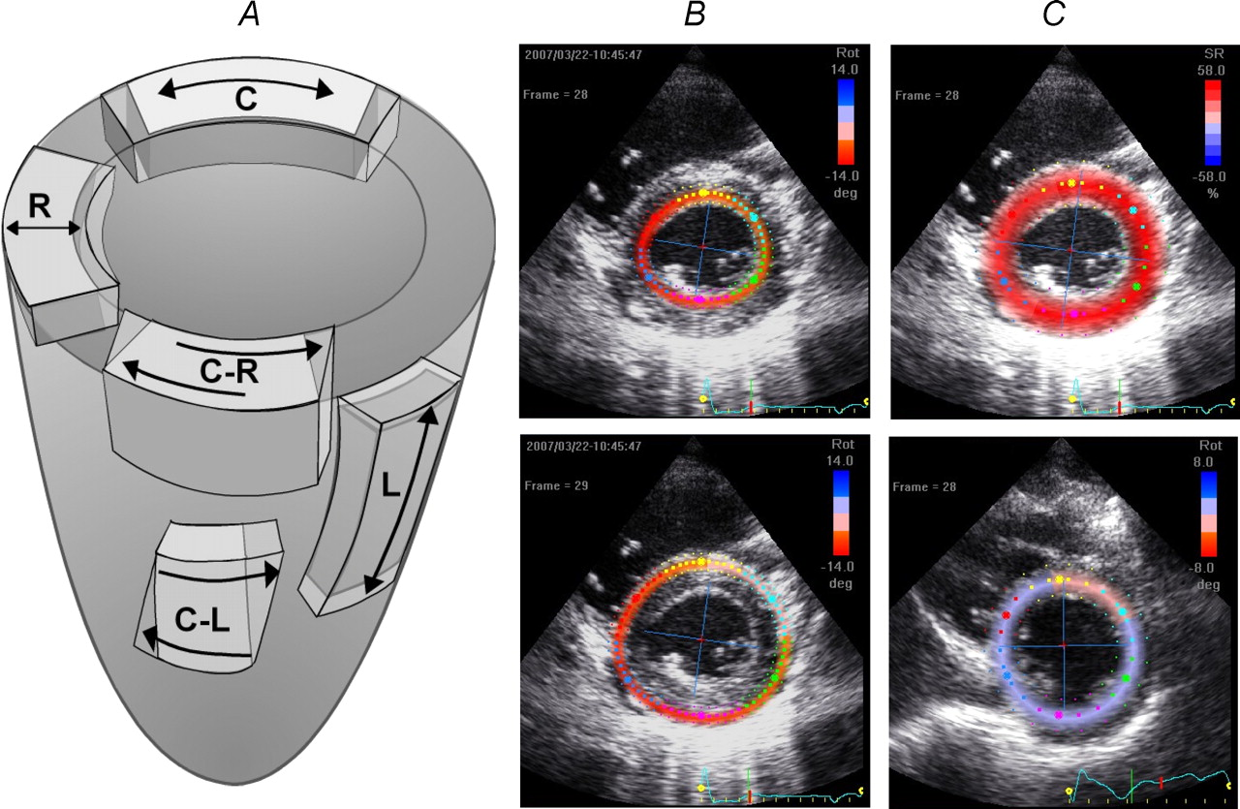

Figure 1 Directions of normal and shear strains A, illustration of the systolic strains evaluated in the study: longitudinal (L), radial and circumferential (C) strains; circumferential–radial (C-R) and circumferential–longitudinal (C-L) shear strains.
Nottin S et al. J Physiol 2008;586:4721-4733
©2008 by The Physiological Society
Notes:
Figure 1 Directions of normal and shear strains A, illustration of the systolic strains evaluated in the study: longitudinal (L), radial and circumferential (C) strains; circumferential–radial (C-R) and circumferential–longitudinal (C-L) shear strains. B, adjustment of the region of interest on both subendocardial and subepicardial layers in order to evaluate the difference of torsion between the inner and outer layers. C, adjustment of the region of interest on the entire myocardium to assess both LV basal and apical rotations.

Slide 15
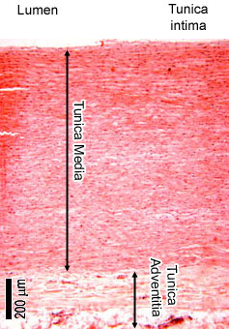
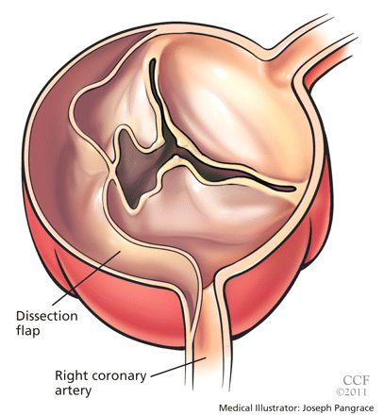
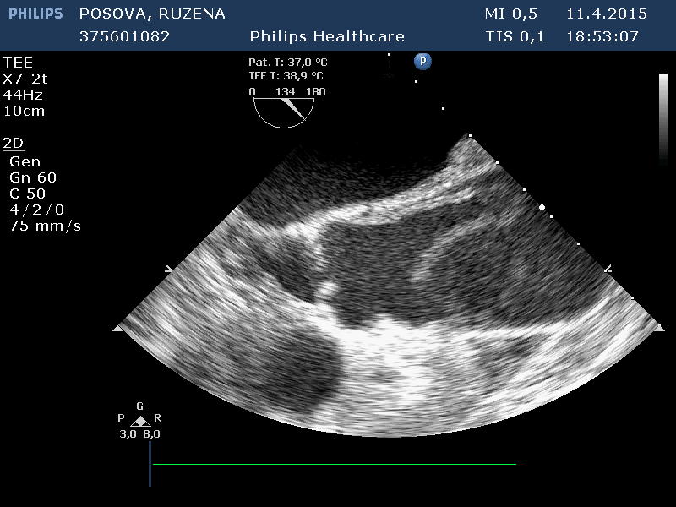
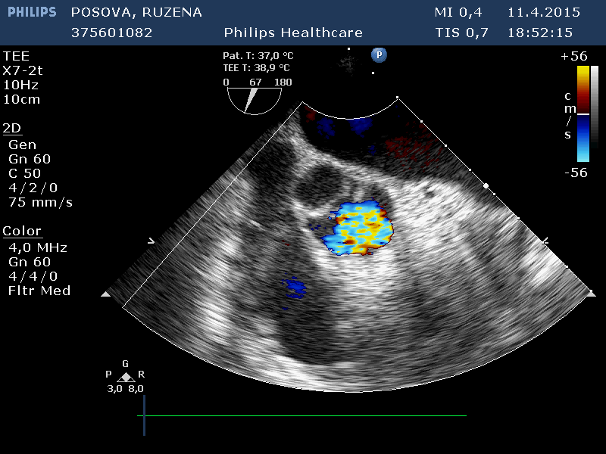
Aortic dissection
www.pinterest.com
Severe aortic regurgitation

Slide 16
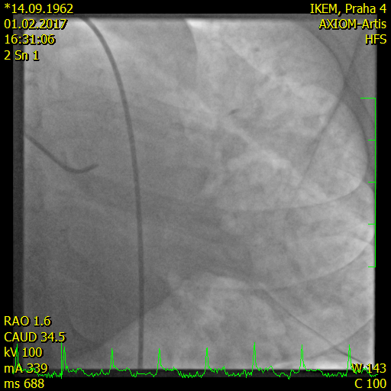
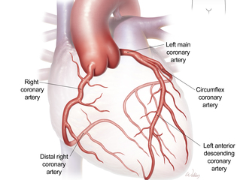
Acute myocardial infartion imaging
Left coronary artery – invasive coronary angiography
http://sphweb.bumc.bu.edu

Slide 17
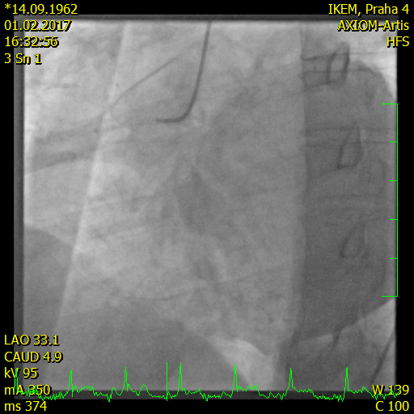
Acute myocardial infartion imaging
Right coronary artery – invasive coronary angiography
http://sphweb.bumc.bu.edu

Slide 18
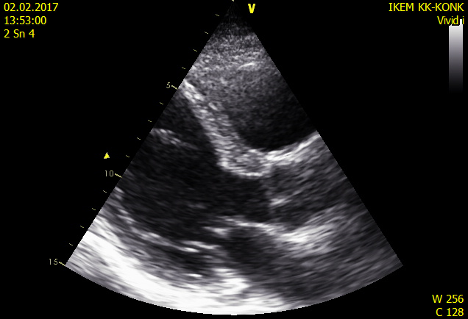
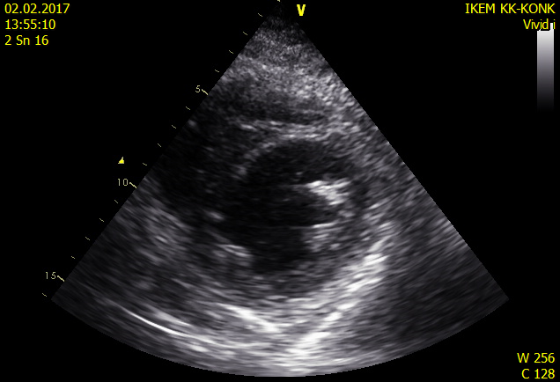
Akinetic septum secondary to left anterior descending artery occlusion

Slide 19
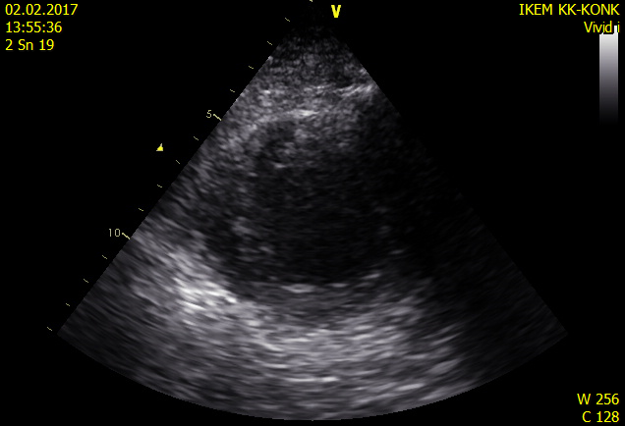
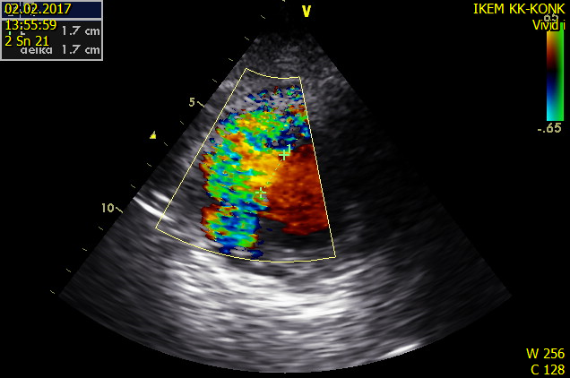
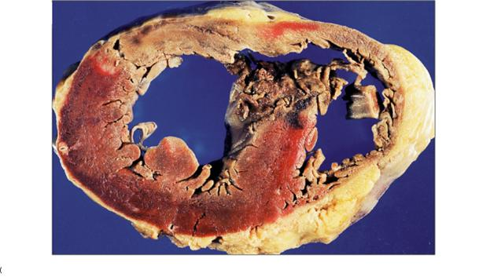
Large septal defect secondary to left anterior descending artery occlusion

Slide 20
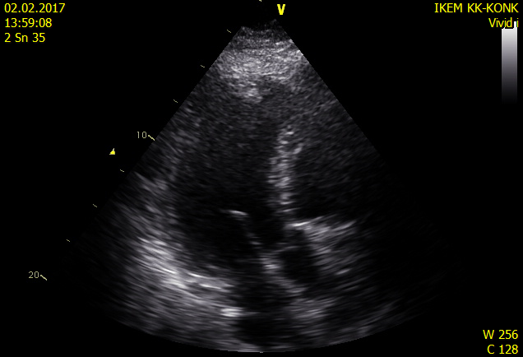
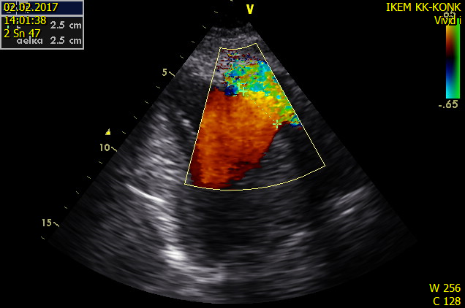
Large septal defect secondary to left anterior descending artery occlusion

Slide 21
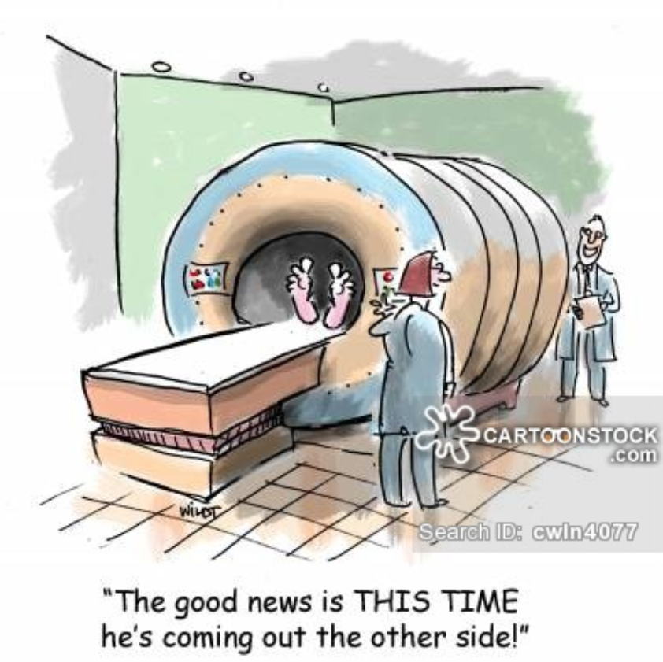
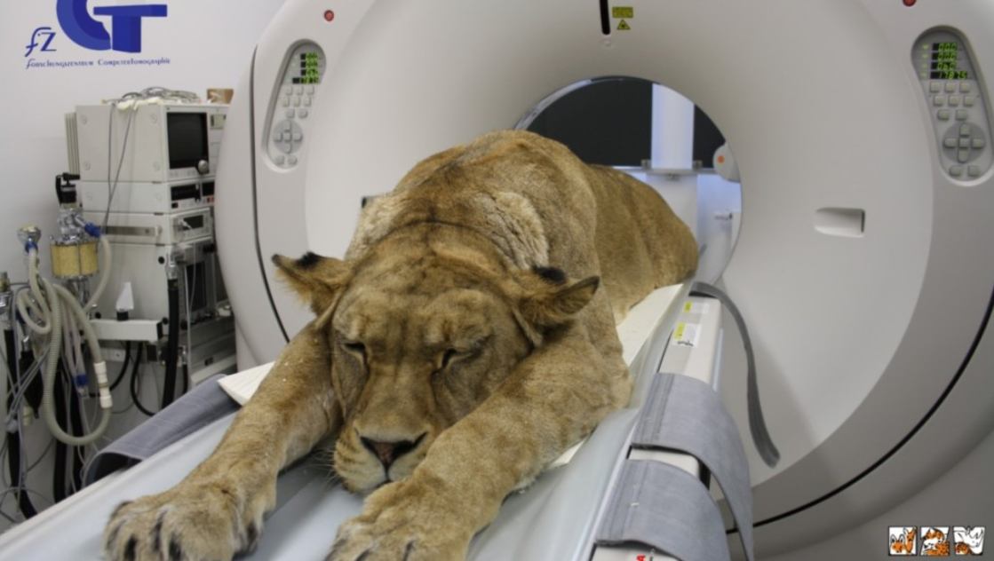
Magnetic resonance imaging MRI
Computed tomography CT
Wildt Chris

Slide 22
CT X MRI
Cadiac CT | Cardiac MRI
10 minutes | 30-90 minutes
CPR in the scanner - yes | CPR in the scanner - never
Radiation - yes | Radiation – no - safe
Contrast agent – required (risk) | Contrast agent – 60% (safe)
Space resolution < 1 mm | Space resolution < 1 mm
Tissue characteristic - limited | Tissue characteristic - perfect

Slide 23

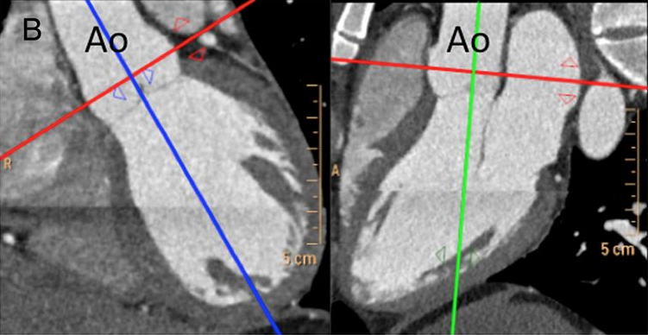
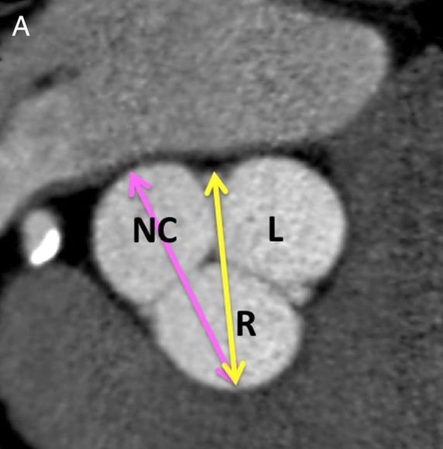
Computed tomography – CT
Aortic root size
Lang e al. JCVI 2015

Slide 24
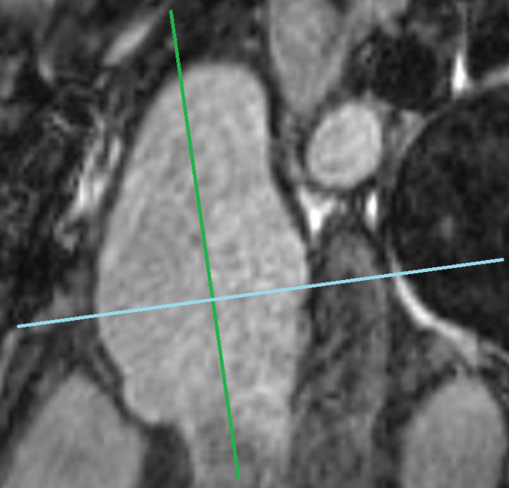
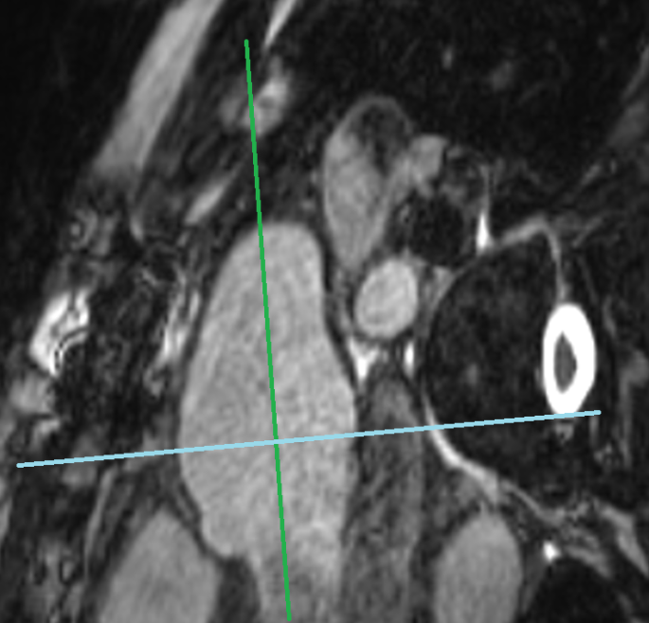
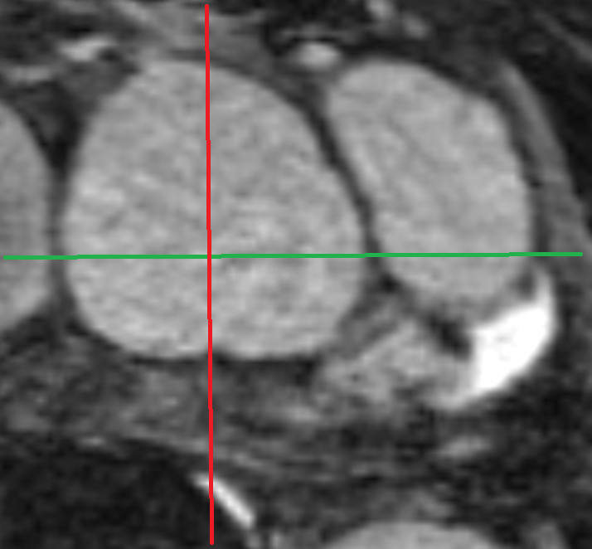

Native MRI
Aortic root size
=

Slide 25


CT coronary angiography
Normal finding Severe LAD stenosis
Female 54 kg, HR 56/min, 0.87 mSv Male 98 kg, HR 54/min 0.81 mSv
Achenbach, JACC Imaging 2011

Slide 26



MR coronary angiography
Right and left coronary art. Right coronary art.

Slide 27






MRI – tissue characteristic
Acute perimyocarditis
*
*
*
T2 fatt sat LGE LGE
Acute myocardial infarction
T2 fatt sat LGE, MVO present LGE

Slide 28

MRI – tissue characteristic
Midwall fibrosis
JAMA, March 6, 2013—Vol 309, No. 9

Slide 29

MRI – cine sequence
Left and right ventricular function

Slide 30


MRI - Left and right ventricular function

Slide 31


MRI - Valve function
Aortic regurgitation
Forward flow 87 ml
Backward flow 45 ml
RF 48% - severe
Aortic regurgitation

Slide 32


Cardiac tumors malignant
Differential diagnosis, complications, invasive grows
*
*
*
*
Sarkoma Brest Ca - metastasis

Slide 33

Cardiac tumors benign - myxoma

Slide 34


4D flow CMR
Dyverfeldt et al. JCMR 2015

Slide 35

4D flow CMR
video
https://www.youtube.com/watch?v=ZlJ8bHrc4qU
www.youtube.com/watch?v=fqbjInQJtzU

Slide 36

4D flow CMR
www.youtube.com/watch?v=NJzoVFkcdnA

Slide 37
Thank you for your attention

