Slide 1
Flat foot Anatomy and current treatment
Institute of Anatomy, 1st Faculty of Medicine
Doc. MUDr. R. Hromádka, PhD.

Slide 2
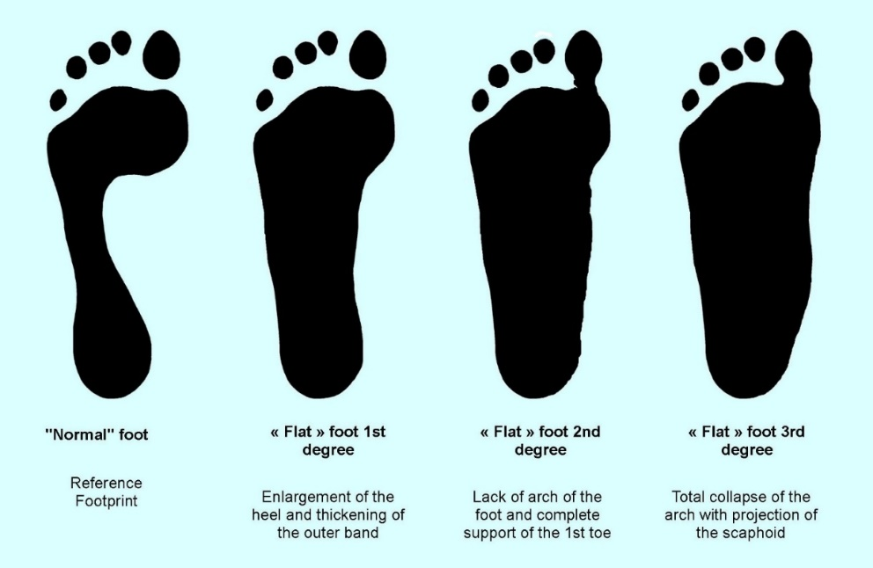
Flat foot
Pes planus
Low medial longitudinal arch of foot
It is not flat forefoot

Slide 3
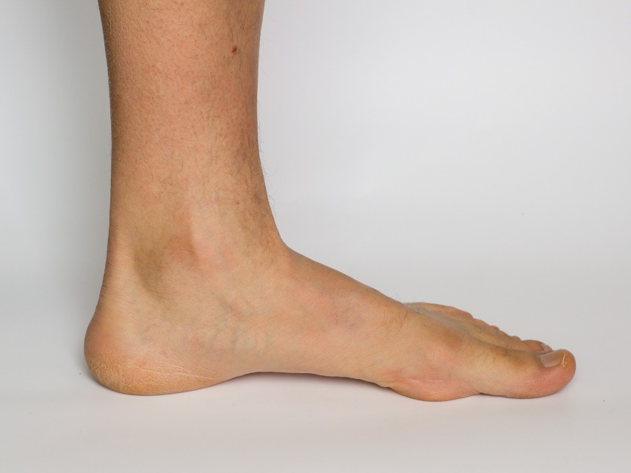
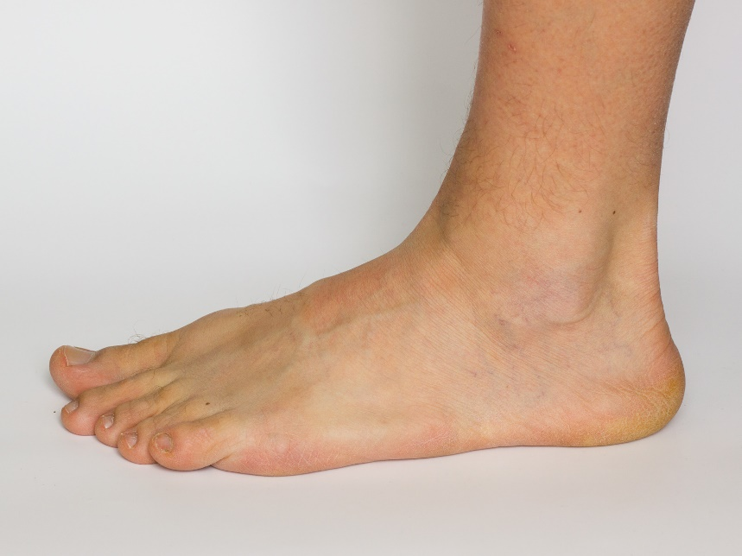
Flat foot
Deformity of whole foot, not only the medial part
Longitudinal arches of foot– medial and lateral
Etiology - congenital predisposition, overweight, connective tissue diseases (e.g. rheumatoid arthritis) , nervous system diseases, etc.
Medial view
Lateral view

Slide 4
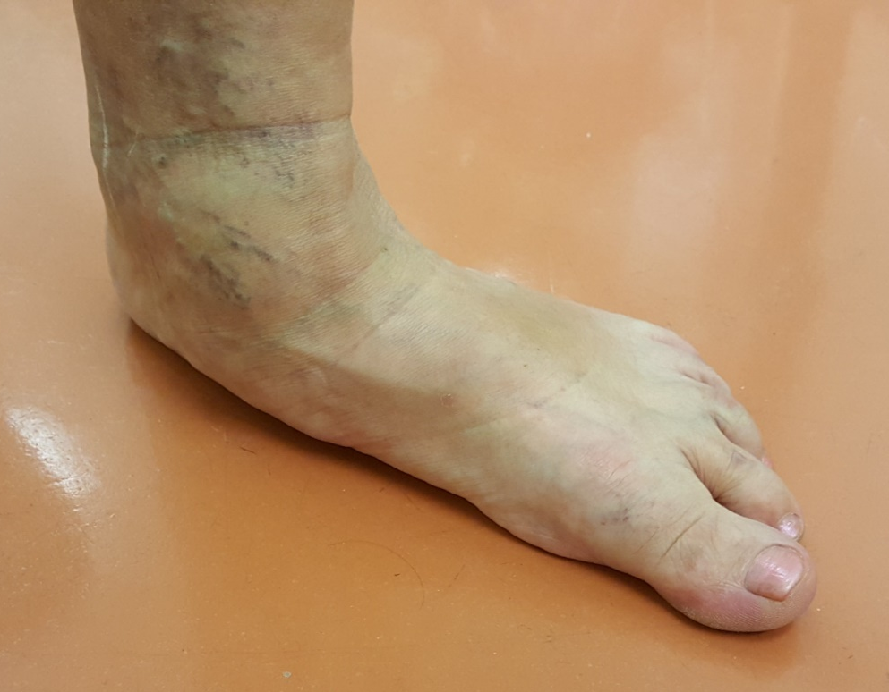
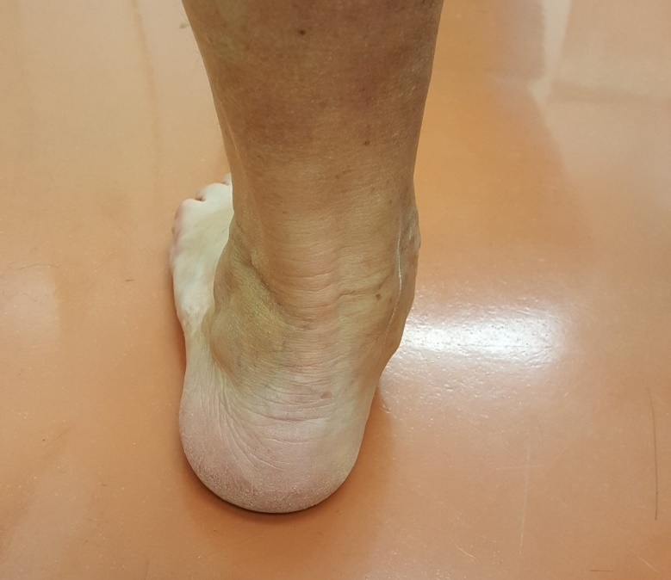
Flat foot
Impairment of soft tissues
„Too many toes“ sign
Valgus position of the heel– Pes planovalgus, (normal up to 10 deg)
Medial side of the foot is overloaded
Posterior view
Medial-anterior view

Slide 5
Flat foot
Hallux valgus – lateral deviation of the big toe at level first metatarsophalangeal joint (MTP)
Valgus position up to 20 degrees is physiological
Pronation of the toe is always pathological
Irritation of the second toe
On medial side of the MTP joint the bunion is irritated

Slide 6
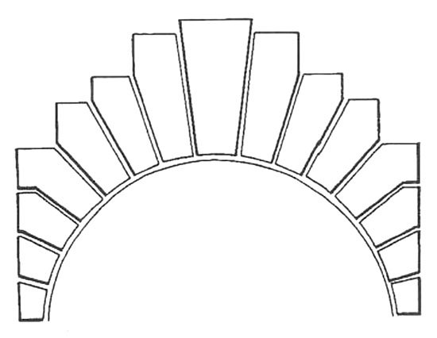
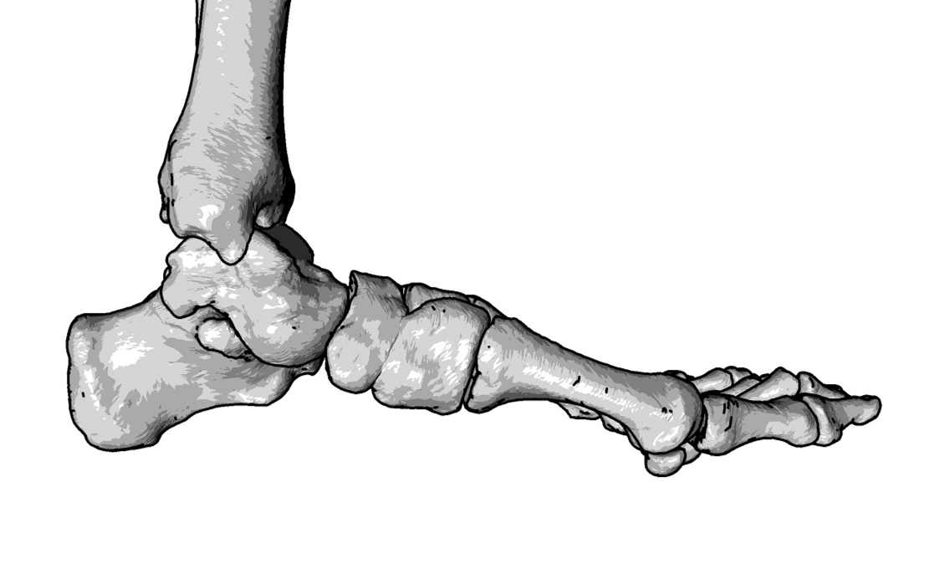
Flat foot
Keystone of masonry arch
Bones of foot form longitudinal and transversal arch
The inner arch is formed: calcaneus, talus, naviculare bone, cuneiform medial bone and the first metatarsal bone

Slide 7
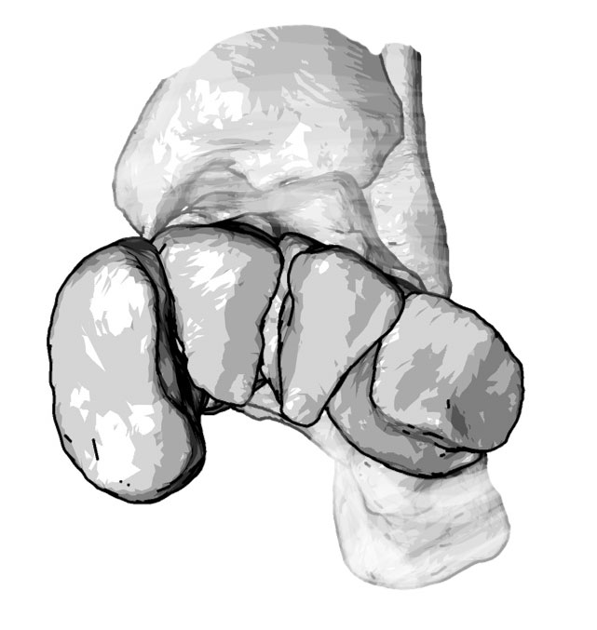
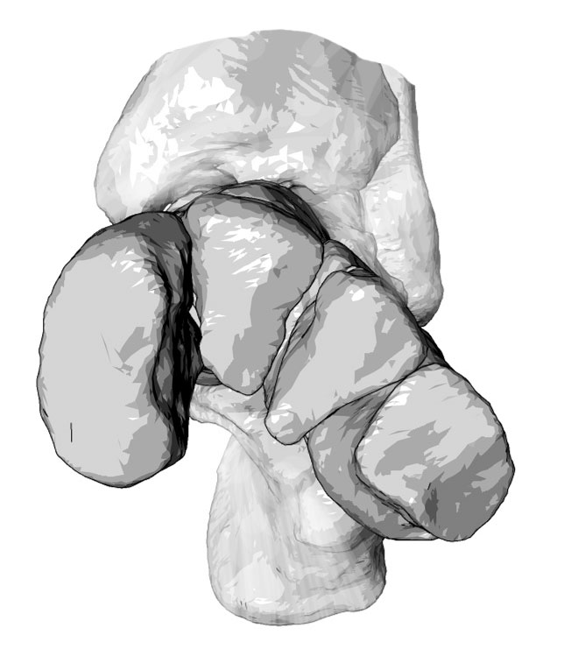
Flat foot
Bones of foot form longitudinal and transversal arch
Transversal arch is at level of cuneiform bones and cuboid bone
Transversal arch is not at level of metatarsal heads

Slide 8
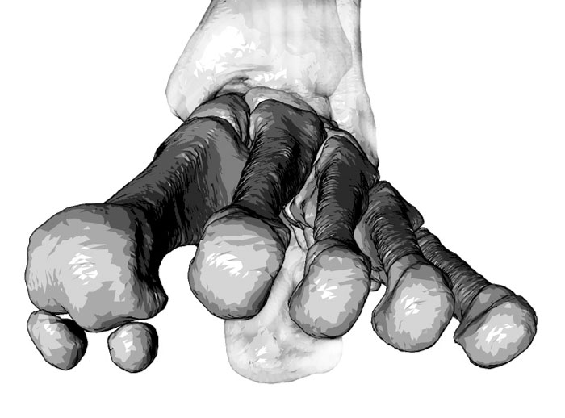
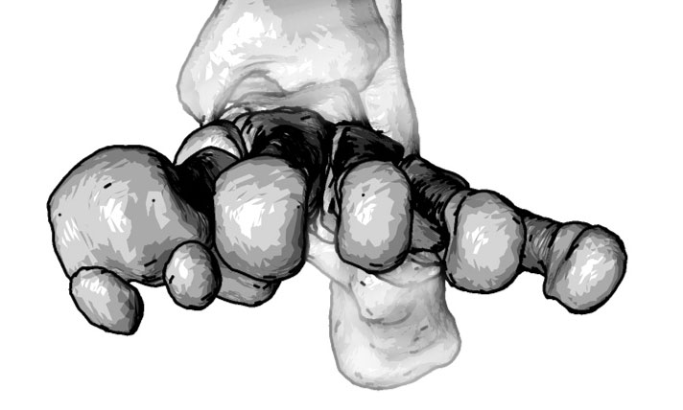
Plochonoží
Bones of foot form longitudinal and transversal arch
Transversal arch is at level of cuneiform bones and cuboid bone
Transversal arch is not at level of metatarsal heads, certainly not during weight bearing

Slide 9
Flat foot
Transversal arch is at level of cuneiform bones and cuboid bone
Transversal arch is not at level of metatarsal heads, certainly not during weight bearing
Positron of the normal foot and flatfoot in a load
Physiological foot with position of the heel bone
Varus position of the forefoot in case of flat foot

Slide 10
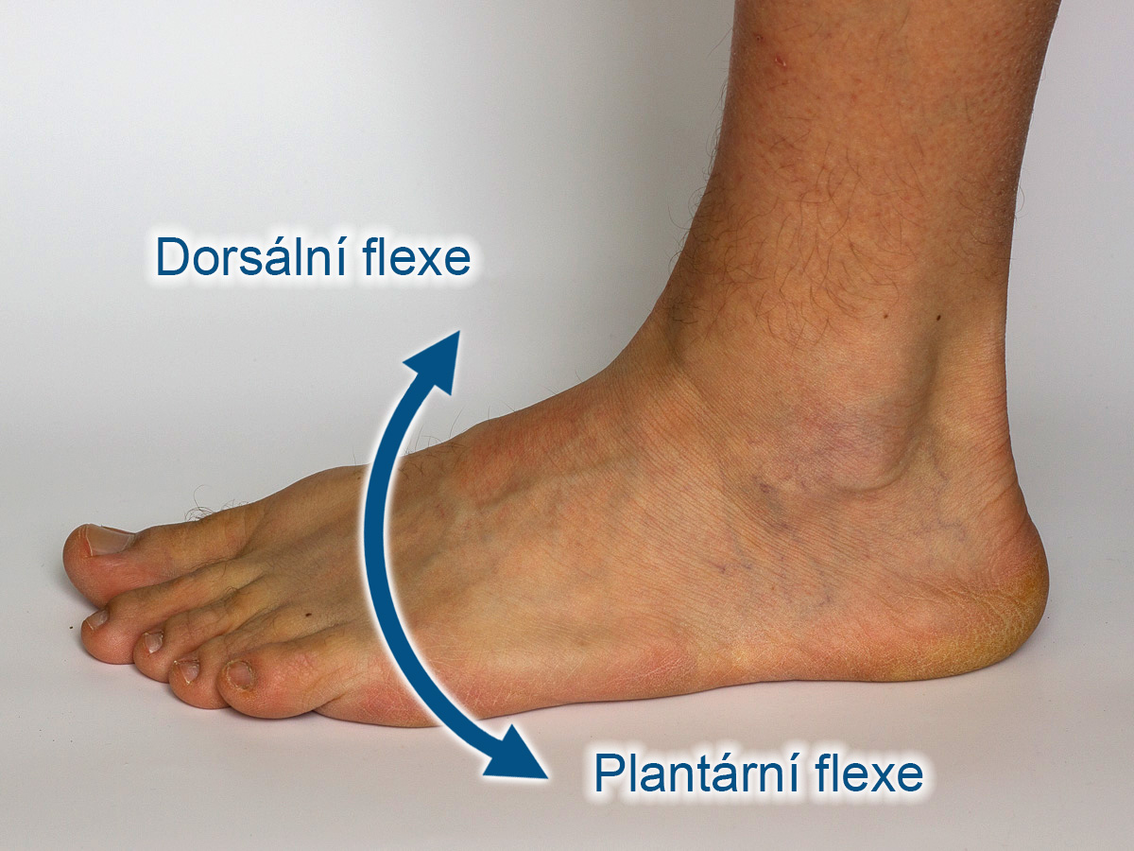
Movement of ankle
Movement of the ankle joint, articulatio talocruralis
Dorsal flexion
Plantar flexion

Slide 11
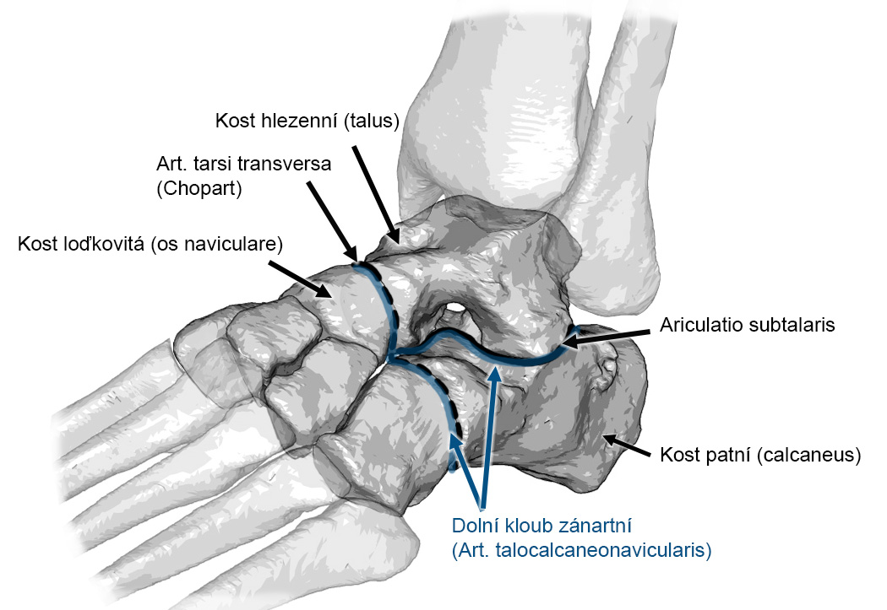
Movement of ankle and foot
Complex joint system lower the ankle
Subtalar joint (talocalcanearis)
Transverse tarsal joint (Chopart’s)
Talonavicular joint
Calcaneocuboid joint

Slide 12
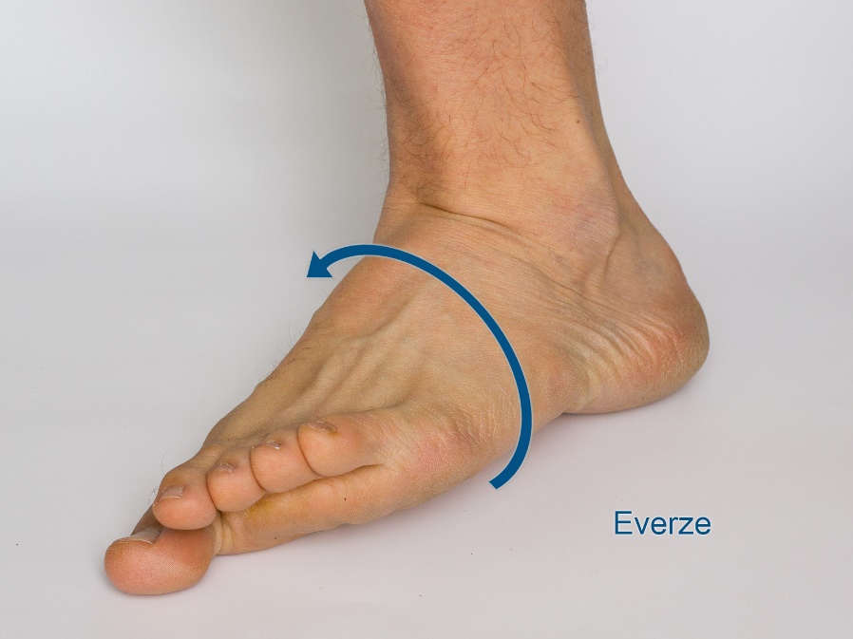
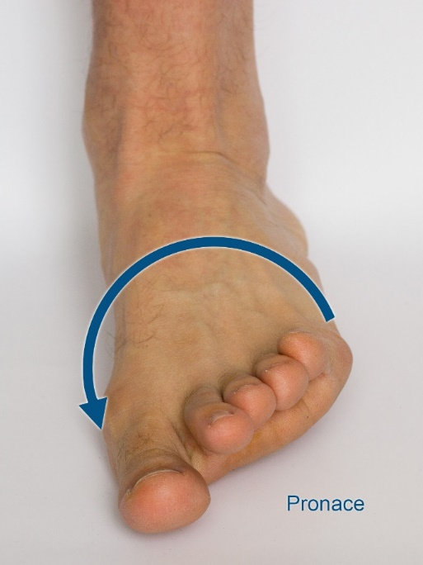
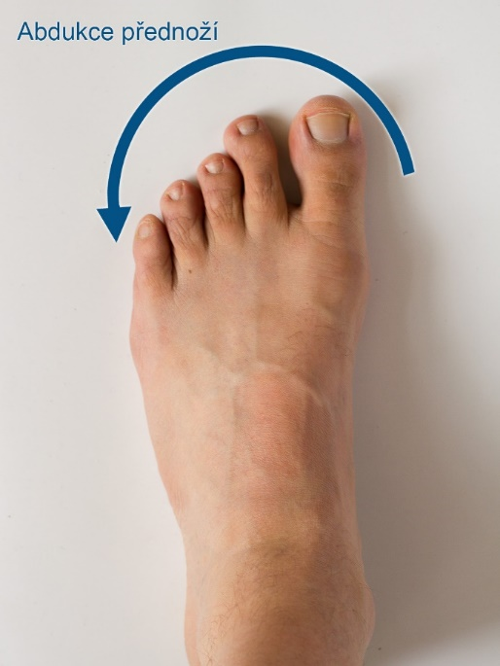
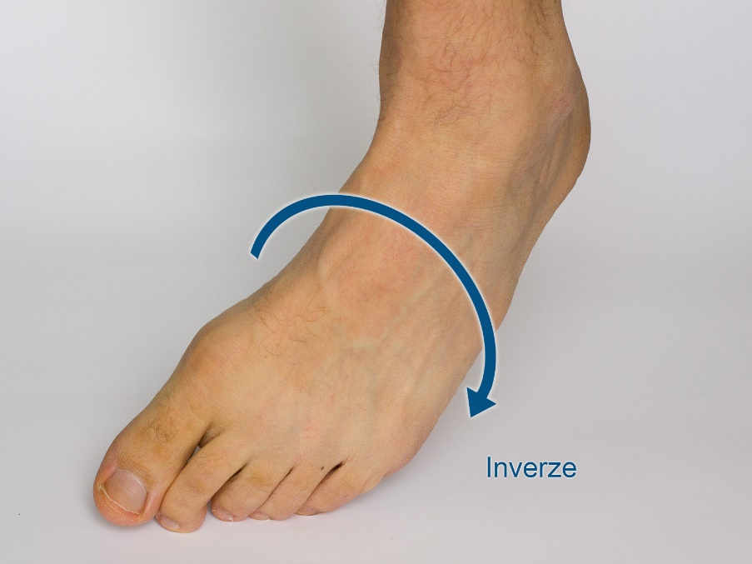
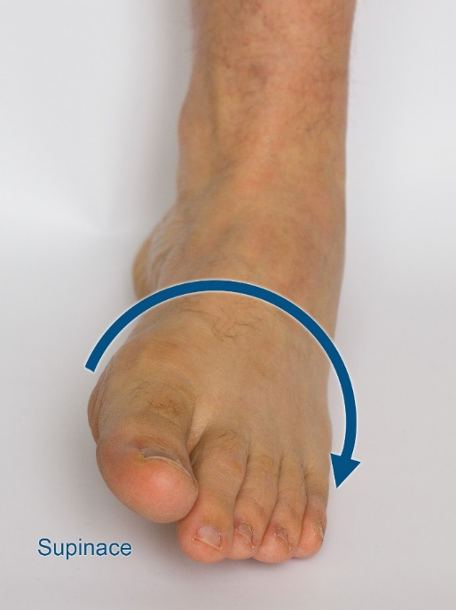
Movements
Eversion
Dorsal flexion
Pronation
Abduction of forefoot
Inversion
Plantar flexion
Supination
Adduction of forefoot

Slide 13
Flat foot
Pes planus is deformity based od improper position of joints below the ankle joint
Static load (dysfunction of static stabilizers)
Dynamic load (dysfunction of dynamic stabilizers)
The foot is like in eversion
The deformity overloads stabilizers of joints lower the ankle joint
Ligaments of the foot
Muscles (tendons) of the foot

Slide 14
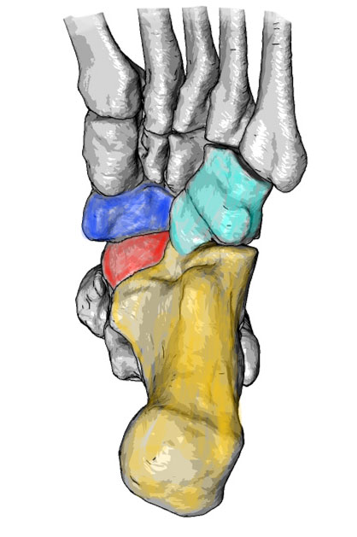
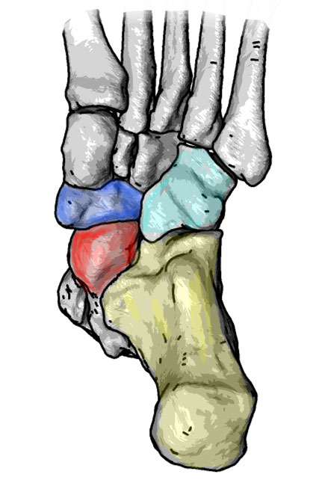
Static stabilizers
Ligaments of the foot are important to hold the foot in proper position in static load (e.g. standing)
form „soft skeleton“ of foot
Important ligaments:
Aponeurosis plantaris
Plantar ligaments of rearfoot
Physiological foot
Flat foot

Slide 15
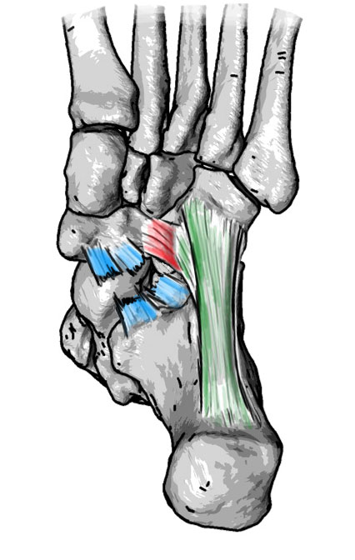
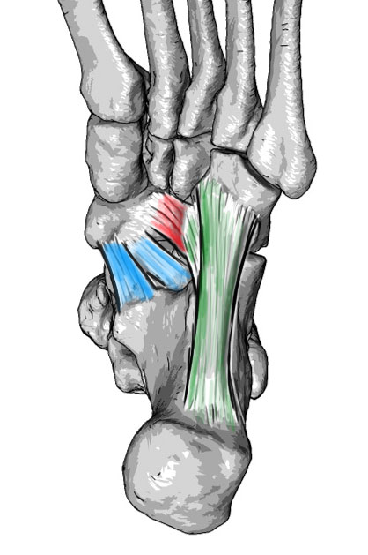
Static stabilizers
Plantar tarsal ligaments (ligg. tarsi plantaria)
Long plantar ligament
On plantar side of the heel bone, cuboid bone, insertion to metatarsals
Calcaneonavicular plantare ligament (Spring ligament)
Main stabilizer of the inner arch
Form the plantar part of the talonavicular joint
In case of its tear the arch drops down
Physiological foot
Flat foot

Slide 16
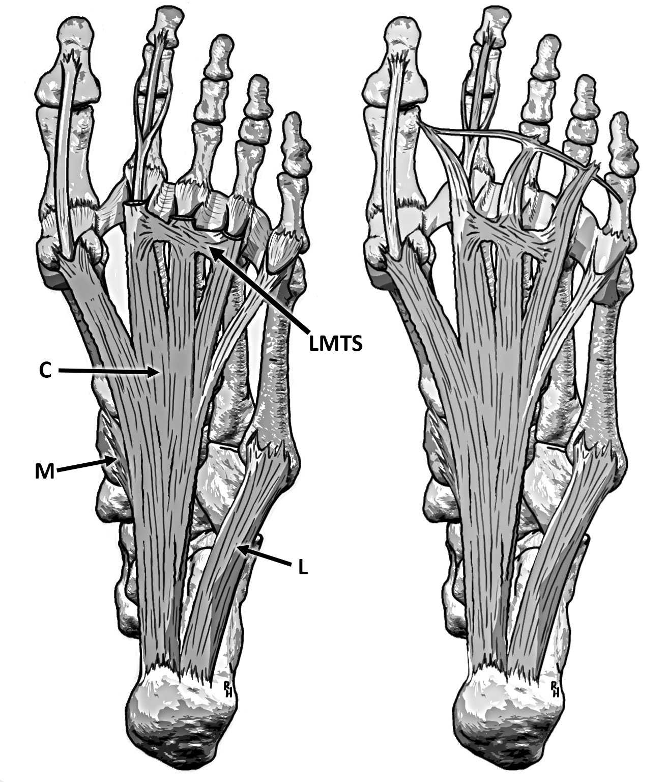
Static stabilizers
Plantar aponeurosis
Medial part
Origin on medial processus of calcaneus
Consists of central, medial and lateral part
Lateral part
Variable part, insertion to 5th metatarsal base

Slide 17
Static stabilizers
Plantar aponeurosis
The central part is inserted thought sagittal septum on fibrocartilago plantaris (plantar plate)
Plantar plate is below each head of metatarsal bone, on plantar side of metatarsophalangeal joint (MTPJ)
Inside of plantar plate of the first MTPJ are sessamoids bones

Slide 18
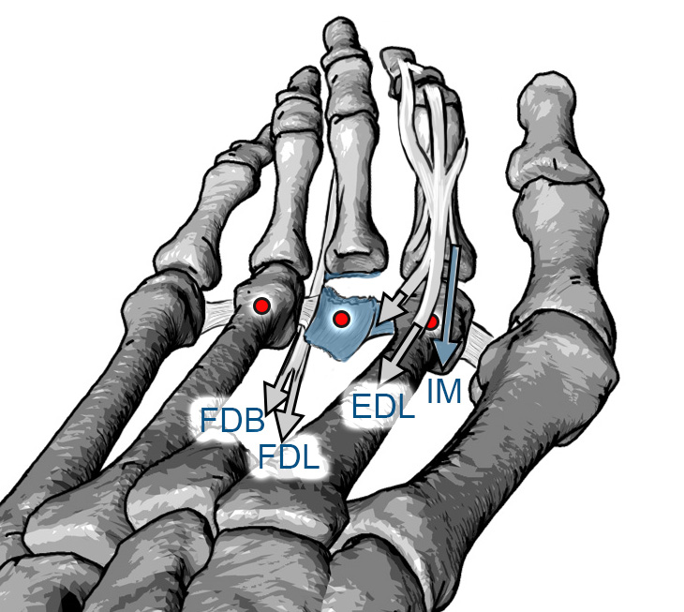
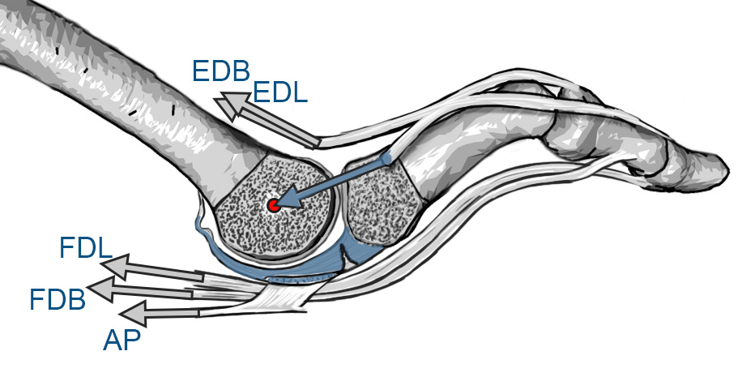
Static stabilizers
Fibrocartilago plantaris – plantar plate, fibrous cartilage, protects and stabilize the joint during a load

Slide 19
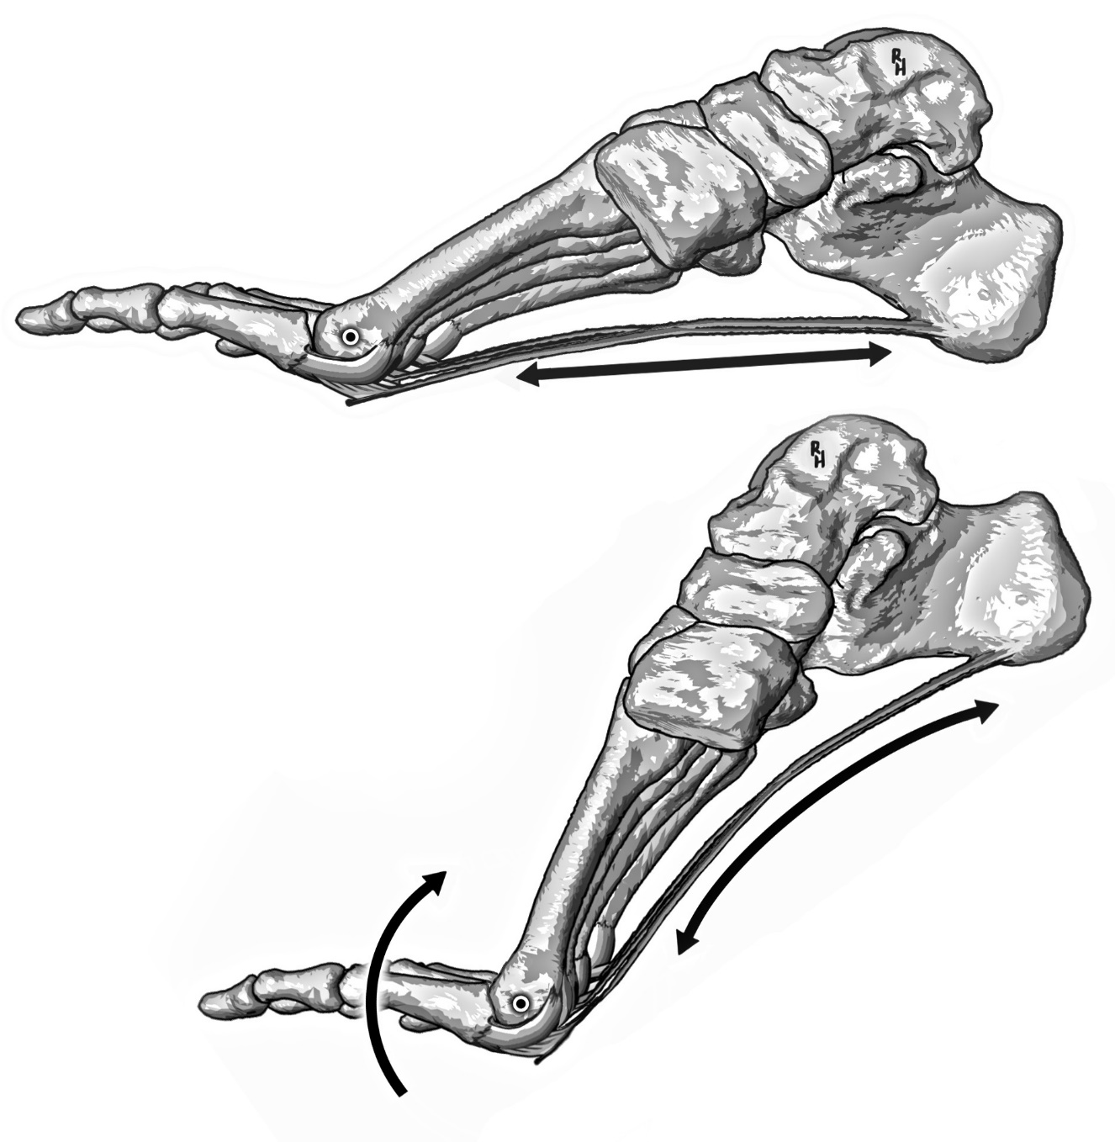
Static stabilizers
Plantar aponeurosis
Inserted on each plantar plate
Aponeurosis holds longitudinal arches
During dorsal flexion of MTPJ arches are more tied

Slide 20
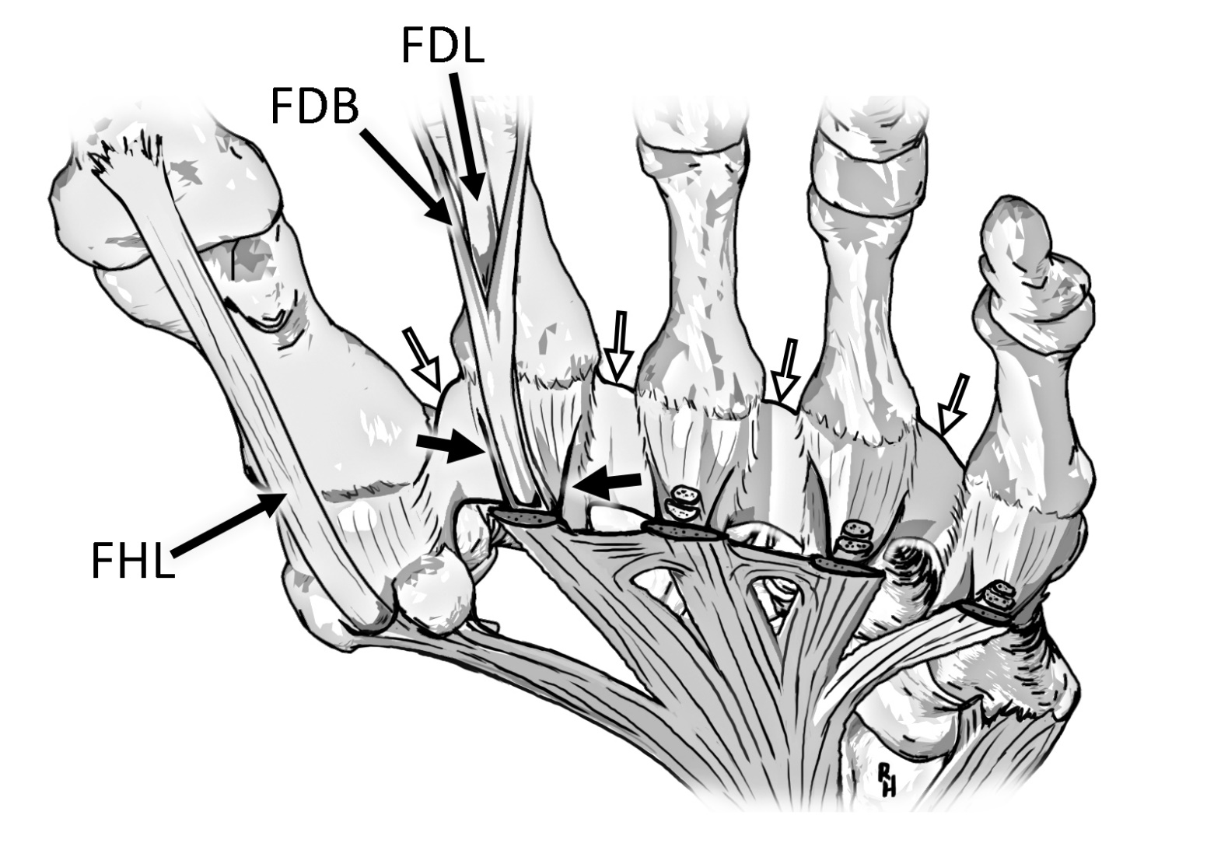
Static stabilizers
Plantar aponeurosis
Transversal connections of the aponeurosis hold the forefoot in transversal plane during load
Plantar plates are like links of a chain below metatarsal heads
The chain, deep transverse metatarsal ligament, ties the forefoot

Slide 21
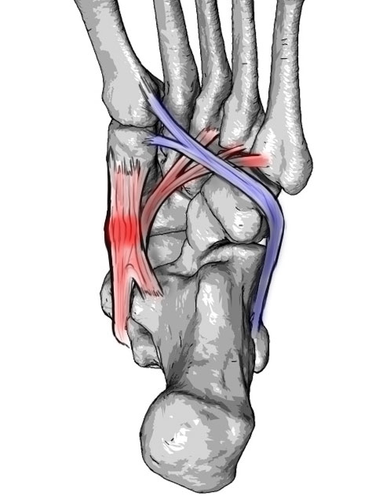
Dynamic stabilizers
Muscles hold proper position of joints during a weight bearing activities (e.g. walking)
Extrinsic muscles
Tibialis posterior muscle
Flexor digitorum longus
Flexor hallucis longus
Triceps surae
Tibialis anterior muscle
Peroneus (Fibularis) longus
Intrinsic muscles
Abductor hallucis longus

Slide 22
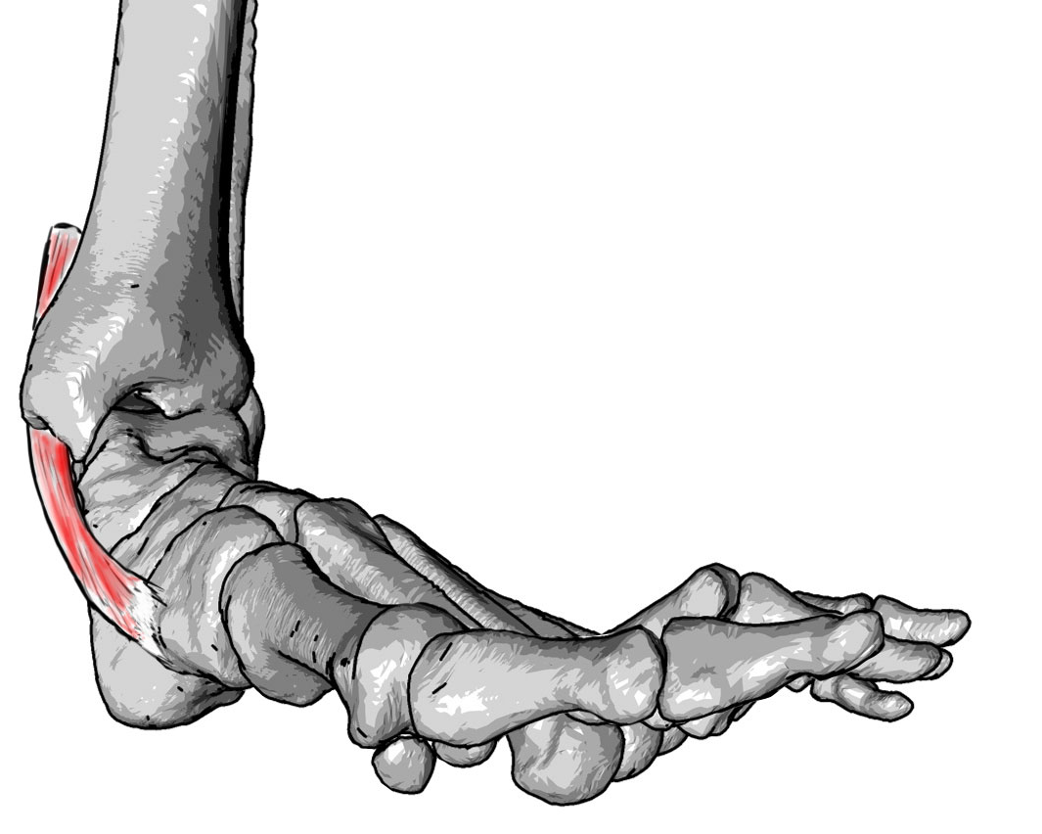
Dynamic stabilizers
Tibialis posterior
Insertion on tuberositas ossis navicularis – elevates the medial margin of the foot
Insertion os sustentaculum tali (talar shelf) holds the talus head n proper position
Insertions to 3rd-5th metatarsal bases do supination of the foot

Slide 23
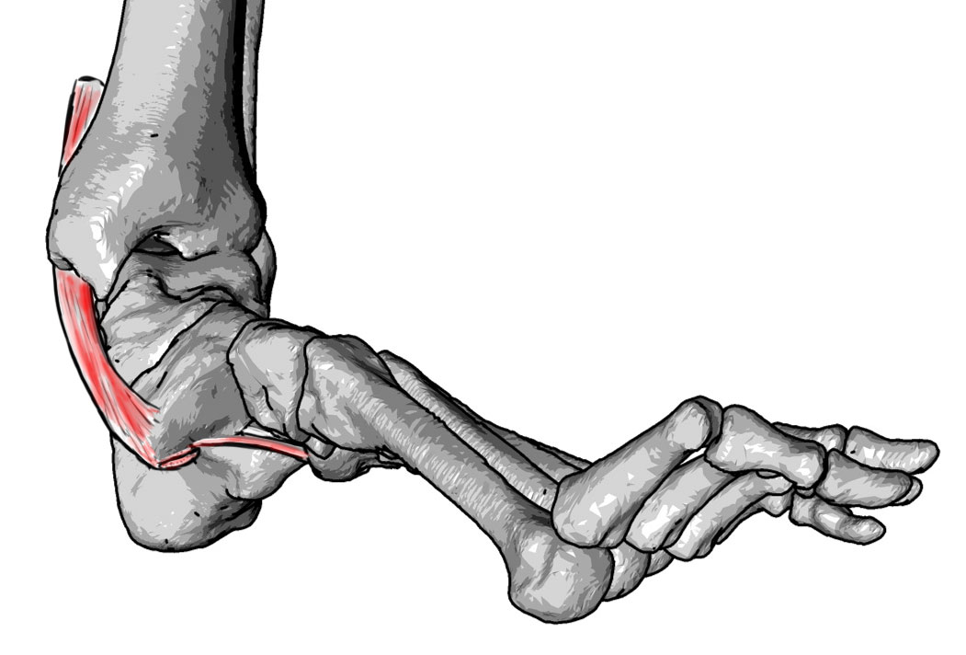
Dynamic stabilizers
Tibialis posterior
Insertion on tuberositas ossis navicularis – elevates the medial margin of the foot
Insertion os sustentaculum tali (talar shelf) holds the talus head n proper position
Insertions to 3rd-5th metatarsal bases do supination of the foot

Slide 24
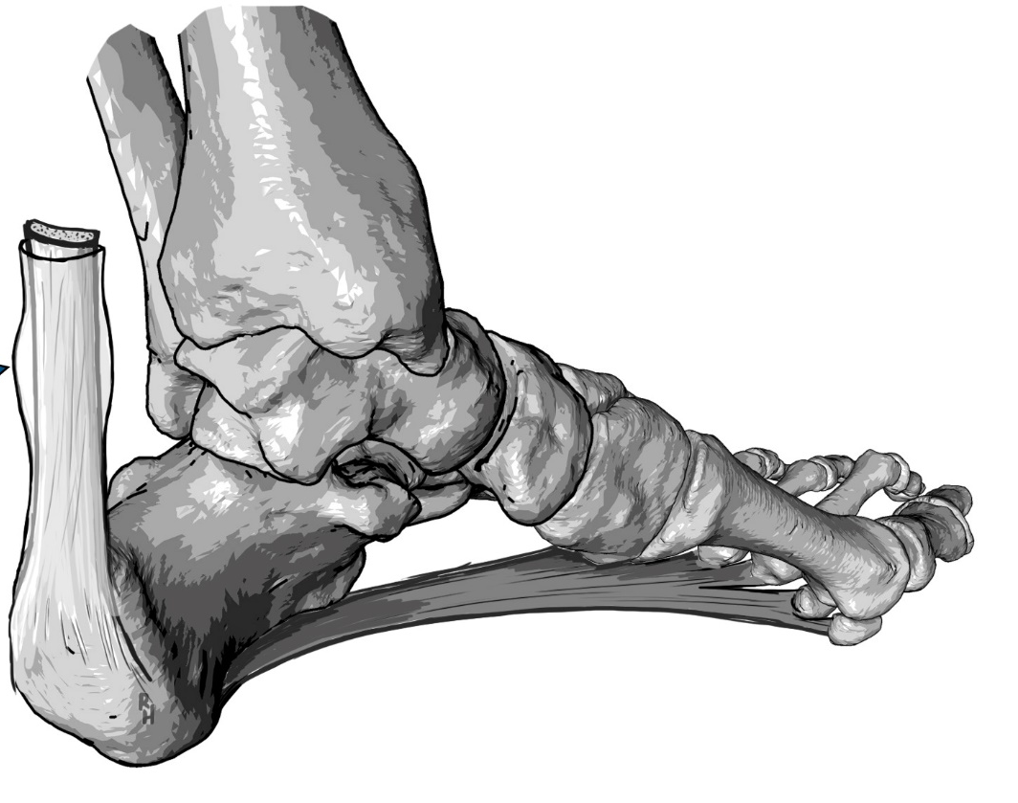
Dynamic stabilizers
Triceps surae
Insertion on calcaneal tuberosity
Some fibers of Achillis tendon are connected to plantar aponeurosis
The muscle turns the heel on flat foot to valgus position

Slide 25
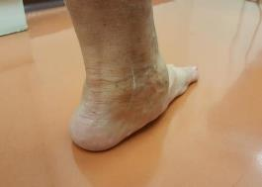
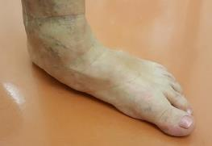
Treatment
Focused to soft tissues (calcaneonaviculare plantare liagament, tibialis posterior tendon)
Valgus position of the heel bone
The medial longitudinal arch
Varus position of the forefoot
Abduction of the forefoot
Hypermobility of first metatarsal bone
The flat foot can be rigid or flexible
The deformity can affects the ankle (talocrural) joint
Operations on flat foot
Procedures on tibialis posterior tendon
PCDO (Posterior displacement calcanear osteotomy)
MCO (Medalizing Calcaneal Osteotomy)
Lateral lengthening procedure
Evans lengtheting procedure

Slide 26
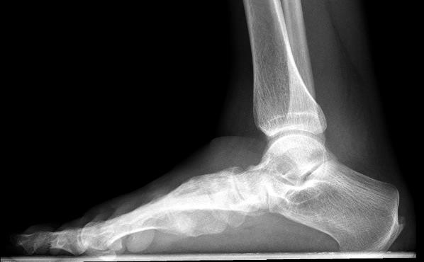
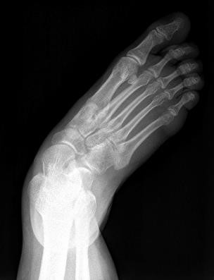
X-rays, side view and AP weight bearing
Meary’s angle
Talonavicular coverage angle

Slide 27
Classification
Stage I – impairment of tibialis posterior tendon (TP)
Stage II - impairment of TP + deformity of the forefoot, the deformity is flexible
Stage III - impairment of TP + deformity of the forefoot, the deformity is rigid
Stage IV – impairment of ankle joint
Stage |  | Physical findings | Treatment
I | IA | Pain TP | Conservative treatment ev. synovectomy
 | IB | Pain TP, synovialitis
 | IC | Valgus heel bone
II | IIA | Varus forefoot | MCO, Synovectomy ev. FDL
 | IIB | Varus forefoot +Abductio of forefoot | MCO, Evans, Synovectomy ev. FDL
 | IIC | Varus forefoot +Abd +Hypermobility of first MTT | MCO, Evans, Cotton
III | IIIA | Rigid rearfoot | Artrodesis (talonavicularis, Subtalaris, double, triple)
 | IIIB | Rigid rearfoot +Abd forefoot
IV | IVA | Flexible valgus TC | Artrodesis, reconstruction of MCL
 | IVB | Rigid valgus TC | TTC Arthrodesis
TP – tibialis posterior; ABD – abductio; MTT – metatarsus; TC- art. talocruralis; MCO – medalizing calcanear osteotomy; FDL – flexor digitorum longus

Slide 28
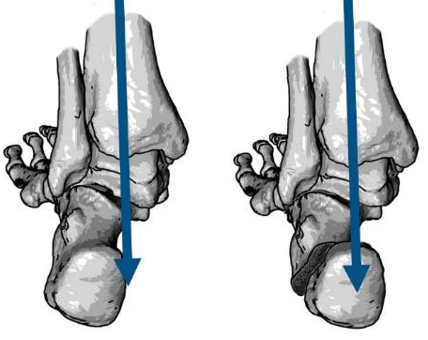
Medalizing Calcaneal Osteotomy (MCO)
shift of Achilles tendon insertion medially
shift of beginning of plantar aponeurosis medially
position change in art. subtalaris, partial correction of its subluxations
Technology operations (open, minimally invasive surgery MIS)
osteotomy (chevron type, one plane)
Different techniques fixation (screws, plates, staples)
One possibility of the osteotomy is a minimally-invasive MCO

Slide 29
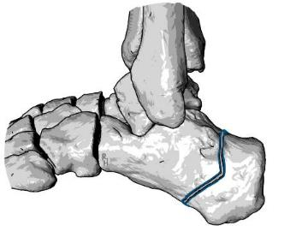
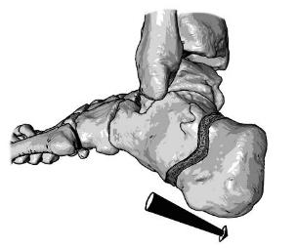
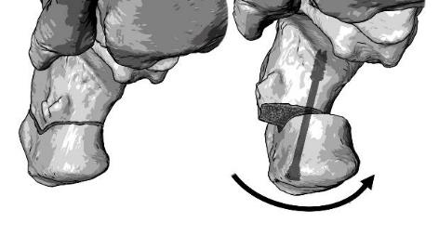
Minimally invasive MCO

Slide 30
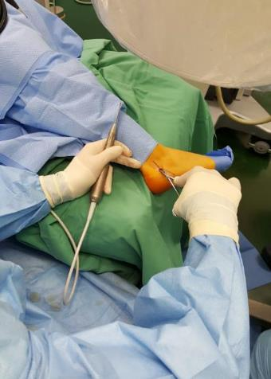
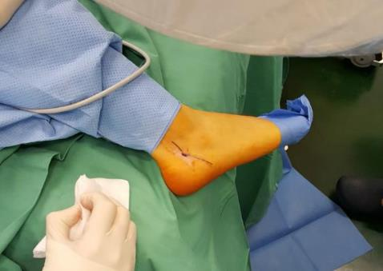
Minimally invasive MCO

Slide 31
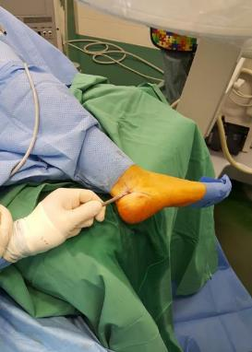
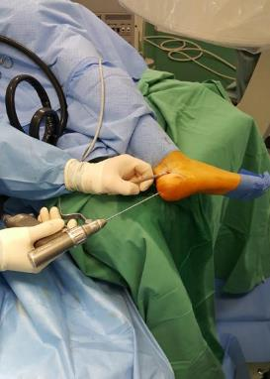
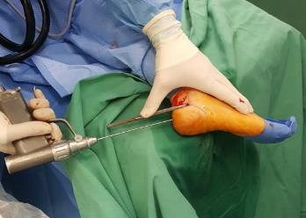
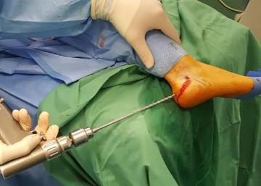
Minimally invasive MCO

Slide 32
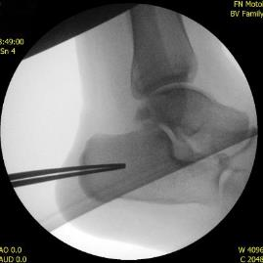
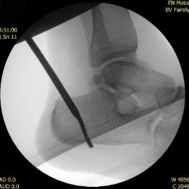
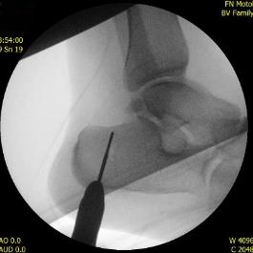
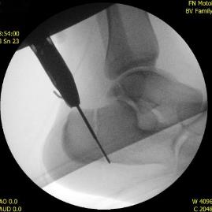
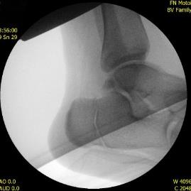
Minimally invasive MCO

Slide 33
Minimally invasive MCO

Slide 34
Synovectomy tibialis posterior tendon
Operation in case of problems at the site of tibialis posterior tendon
If the tendon is interrupted performs its synovectomy i.e. removal inflammatory synovium from its surface
If a tendon is torn, its end is inserted to tuberosity of navicular bone
If the tendon is destroyed, the tendon of flexor digitorum longus is used

Slide 35
Tendosynovectomy tibialis posterior

Slide 36
Evans osteotomy
Lateral lengthening procedure
The principle is prolongation of lateral column of the foot, due osteotomy of the calcaneus
Extending leads to adduction of forefoot and its pronation
Various modifications (Hintermann)
Different types of osteotomy fixation (screw plate, KI wires, without fixation)
Using grafts / u, without using

Slide 37
Evansova osteotomie
Operační postup
Podélný přístup s ploskou nohy nad horním okrajem šlachy m. fibularis brevis
Osteotomie oscilační pilou a pak dlátem
Zavedení KI drátů a distrakce osteotomie
Vložení trikortikálního kostního štěpu z os ilium
Případná fixace osteotomie dlahou

Slide 38
Evans osteotomy

Slide 39
Evans osteotomy

Slide 40
Postoperative care
Standard ATB prophylaxis
Postoperative high plaster of Paris splint or inflated boot
Change dressing 1 or 2 postoperative day
Walking on crutches for 6-8 weeks
Physiotherapy starts 3 or 6 postoperative week

Slide 41
Conclusion
Flat foot is a complex deformity of foot legs and affects bone structures, ligaments and muscles
The deformity is ussualy based on disposition and improper load (e.g. overweight)
Untreated flat foot leads to irreversible changes in the foot joints
Operations can solve all components of deformity up to second stage
Some treatments can also be performed minimally invasive

Slide 42
Thanks for your attention

