Slide 1
ANATOMY OF GENITOURINARY SYSTEM MUDr. T. Hradec Urologická klinika 1.LF UK a VFN Přednosta Prof.MUDr.T.Hanuš, DrSc.

Slide 2
Genitourinary system
Kidneys, adrenal glands
Upper urinary tract- calices, pelvis, ureter
Lower urinary tract- urinary bladder, urethra
Male genital organs- prostate, seminal vesicles, penis, scrotum, testes, epididymis

Slide 3
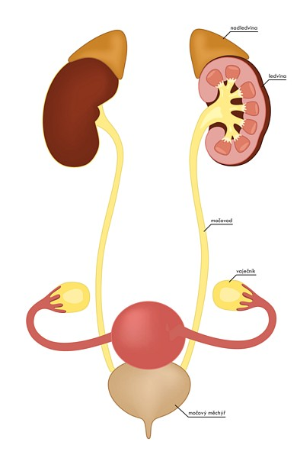

Slide 4
Kidneys
retroperitoneum
Th12-L2
right kidney lower- liver
facies anterior/posterior
margo medialis (concave)
lateralis (convex)
extremitas superior/inferior
renal capsula – fibrous tissue
perinephric fat
renal fascia (Gerota)

Slide 5
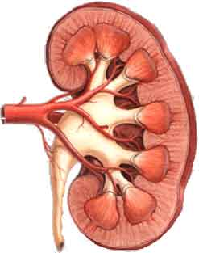
Kidneys
Cortex- nephrons
Medulla- renal columns, pyramids, collecting ducts, papilla
Calices- minor and major
Pelvis
Renal hilum
- ureter
- renal artery
- renal vein
- hilar fat
- lymphatic tissue (nodes)
Blood supply
- renal artery (aorta)
- accesory renal artery (30%)
- renal vein (vena cava inf.)

Slide 6
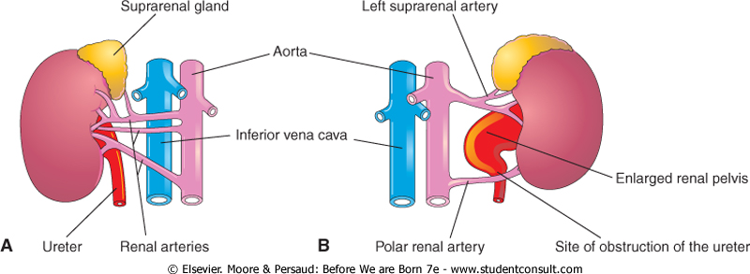

Slide 7
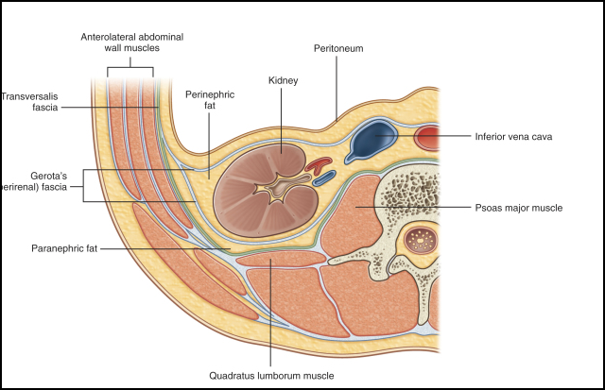

Slide 8
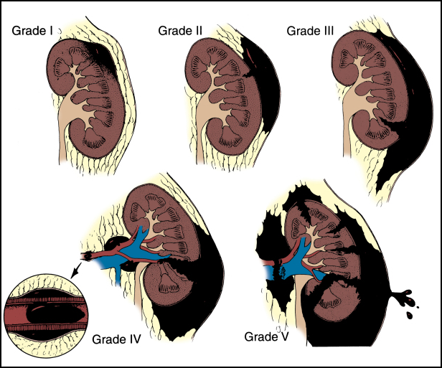
Injuries to the Kidneys - Classification

Slide 9
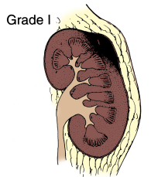
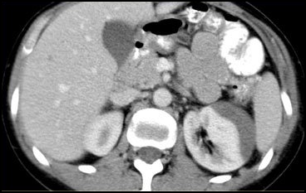
grade I: contusion or non-enlarging subcapsular perirenal haematoma, and no laceration
treatment: hydration, observation

Slide 10
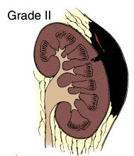
grade II: superficial laceration <1 cm depth and does not involve the collecting system (no evidence of urine extravasation), non-expanding perirenal haematoma confined to retroperitoneum

Slide 11
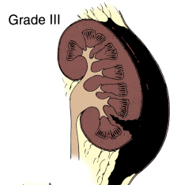
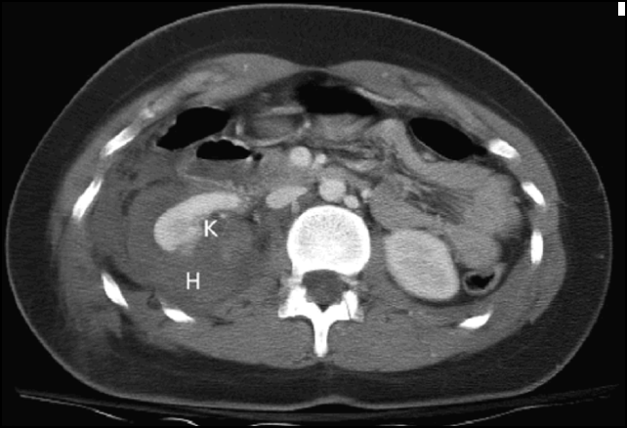
grade III: laceration >1 cm without extension into the renal pelvis or collecting system (no evidence of urine extravasation)
treatment: observation in stabilisated cases
surgery in hypotension, increasing hematoma, massive hematuria, shock

Slide 12
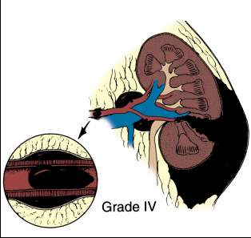
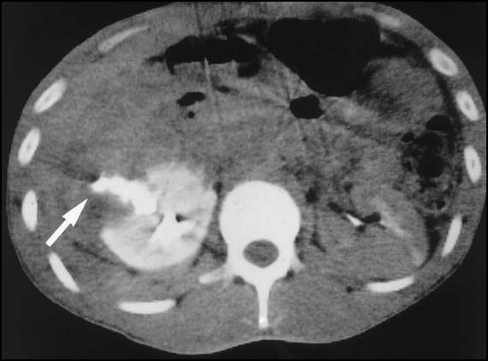
grade IV
laceration extends to renal pelvis or urinary extravasation
vascular: injury to main renal artery or vein with contained haemorrhage
segmental infarctions without associated lacerations
expanding subcapsular haematomas compressing the kidney

Slide 13
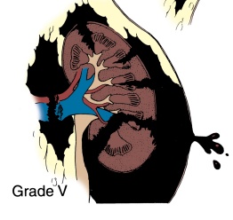
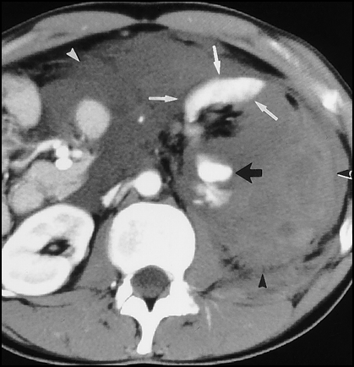
grade V
shattered kidney
avulsion of renal hilum: devascularisation of kidney due to hilar injury
ureteropelvic avulsions
complete laceration or thrombus of the main renal artery or vein

Slide 14
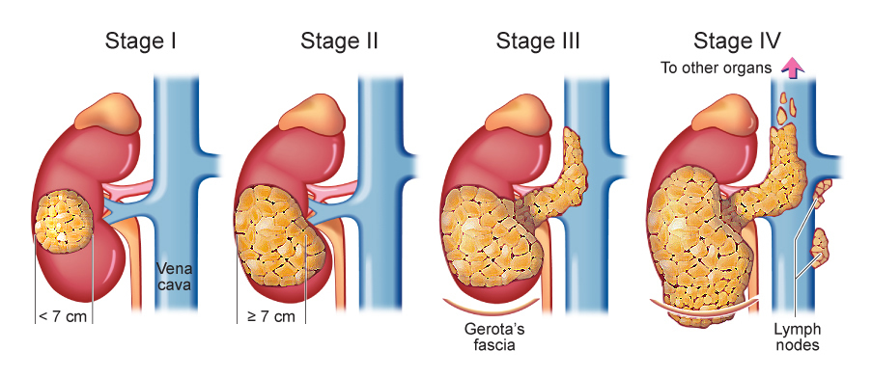
Renal cell carcinoma

Slide 15
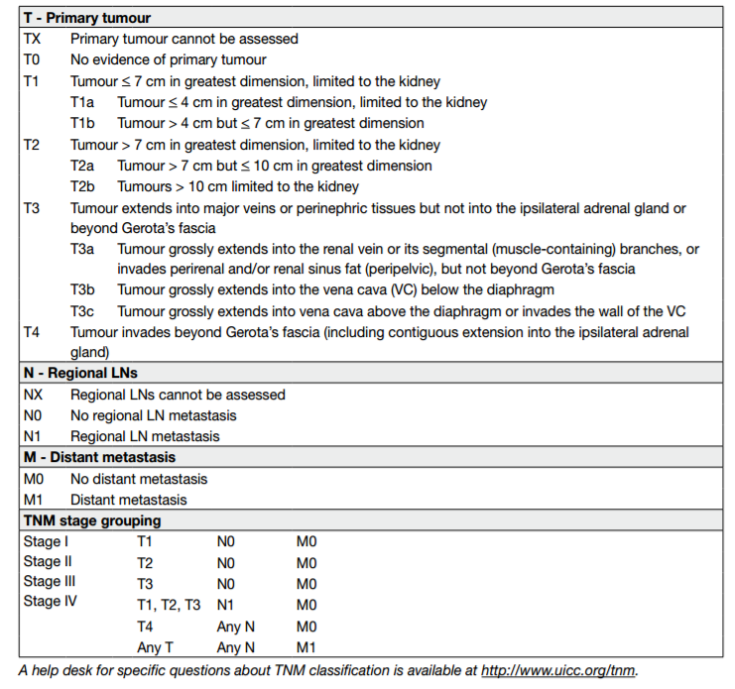
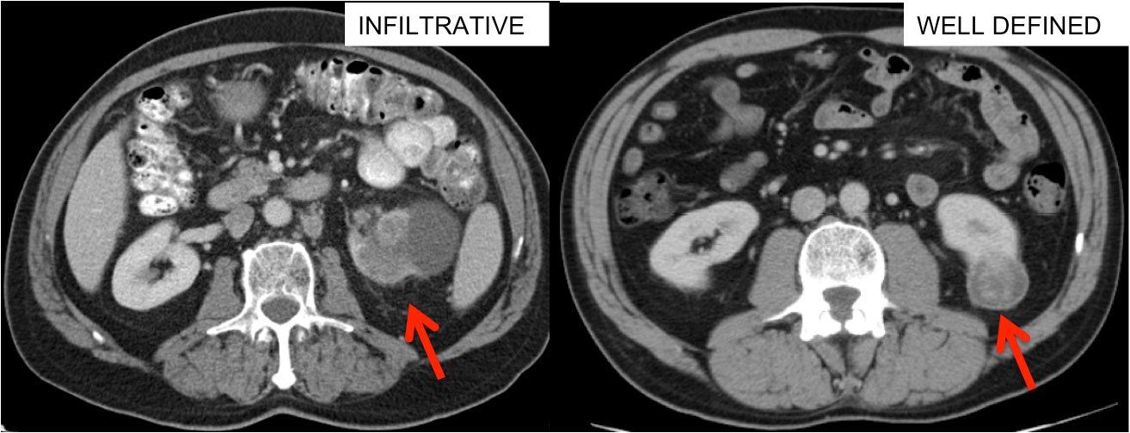
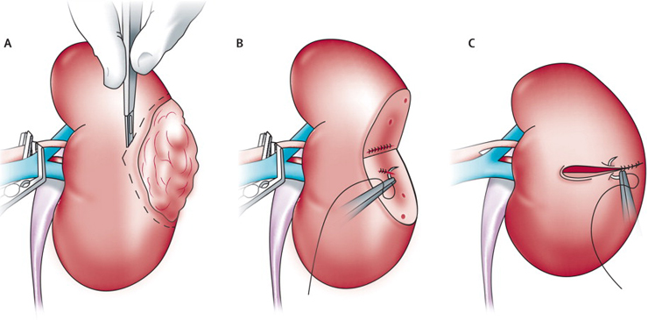

Slide 16
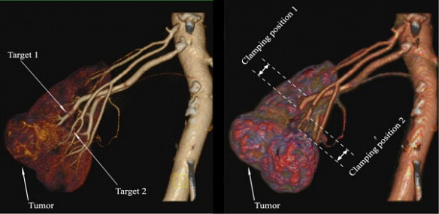
Clamping of segmental artery

Slide 17
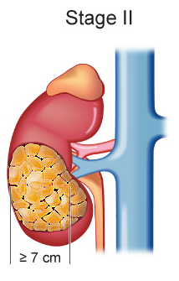

Slide 18
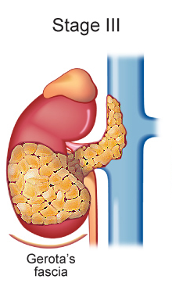

Slide 19
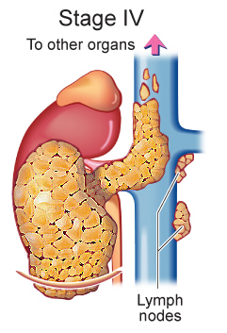

Slide 20
Upper urinary tract
Ureter
25–30 cm
2-4 mm
transitional epithelium
smooth muscle (peristalsis)
Ureter narrowing
(impaction of kidney stones)
- pelvouteric junction
bifurcation of the iliac arteries
ureterovesical valve
In females, the ureters pass through the mesometrium and under the uterine arteries

Slide 21
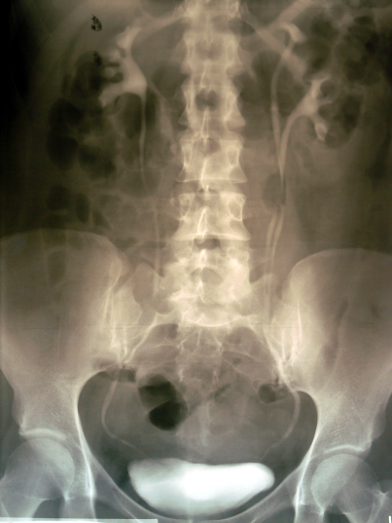
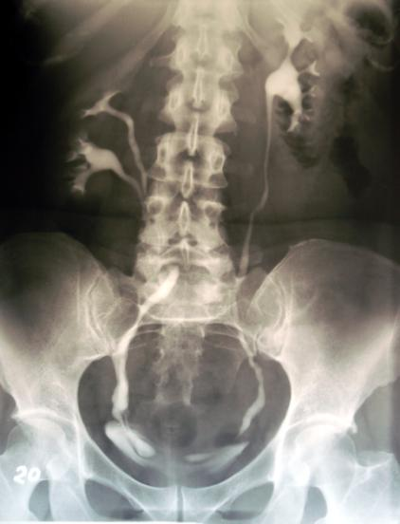

Slide 22
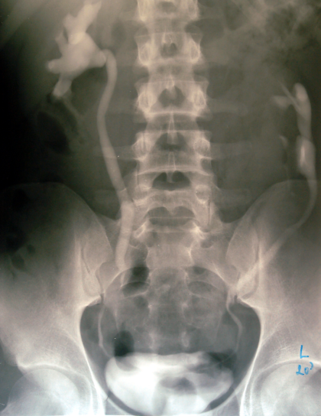
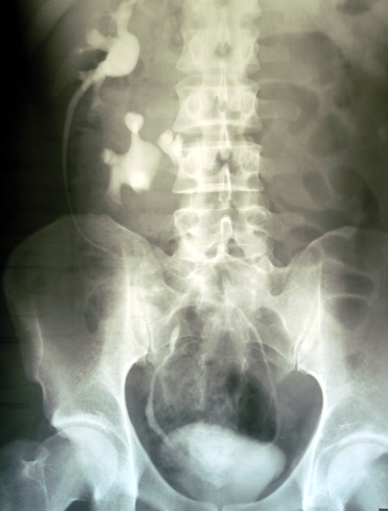

Slide 23
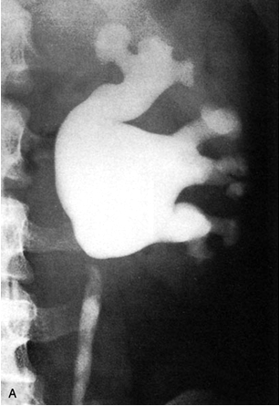
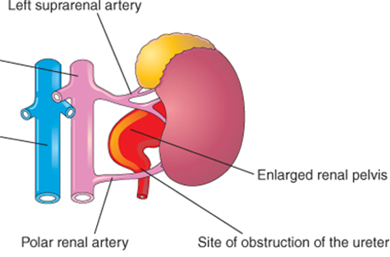
Congenital hydronephrosis
Ureteropelvic junction (UPJ) obstruction
Ureterovesical junction (UVJ) obstruction
Posterior urethral valves (PUV)
Ureterocele
Vesicoureteral reflux

Slide 24
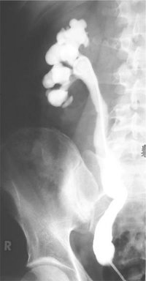
Congenital hydronephrosis
Ureteropelvic junction (UPJ) obstruction
Ureterovesical junction (UVJ) obstruction
Posterior urethral valves (PUV)
Ureterocele
Vesicoureteral reflux

Slide 25
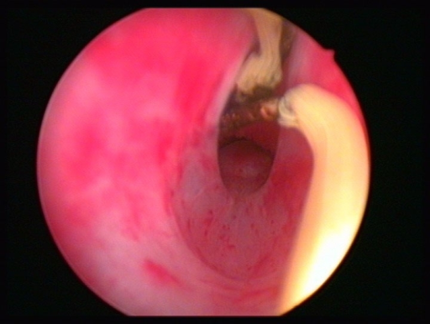
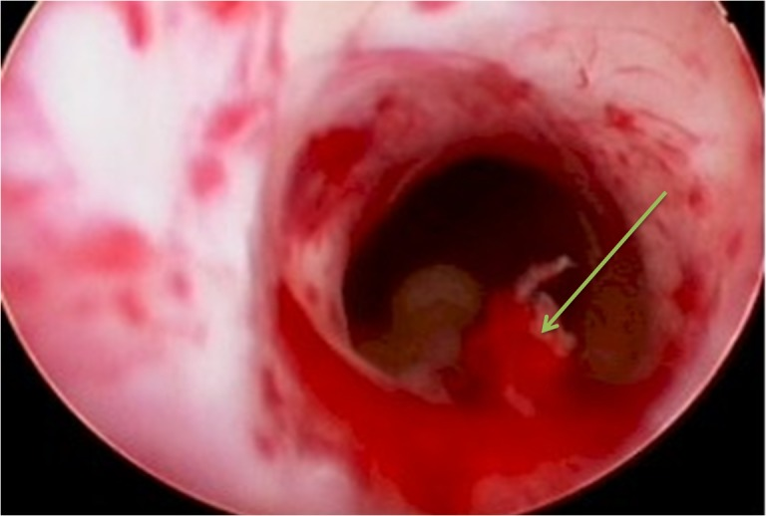
Congenital hydronephrosis
Ureteropelvic junction (UPJ) obstruction
Ureterovesical junction (UVJ) obstruction
Posterior urethral valves (PUV)
Ureterocele
Vesicoureteral reflux

Slide 26
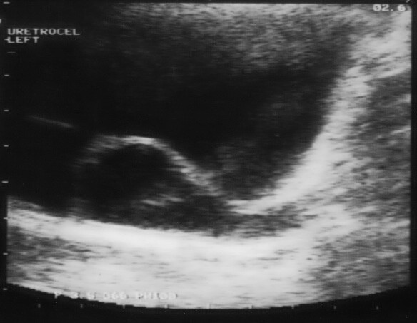
Congenital hydronephrosis
Ureteropelvic junction (UPJ) obstruction
Ureterovesical junction (UVJ) obstruction
Posterior urethral valves (PUV)
Ureterocele
Vesicoureteral reflux
congenital abnormality – distal ureter balloons at its opening into the bladder, forming a sac-like pouch
Treatment - endoscopic incision, which can be followed by surgical ureteric re-implantation

Slide 27
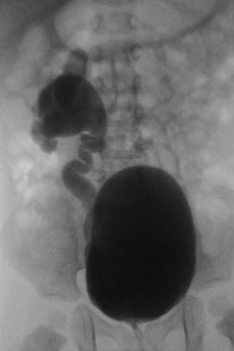
Congenital hydronephrosis
Ureteropelvic junction (UPJ) obstruction
Ureterovesical junction (UVJ) obstruction
Posterior urethral valves (PUV)
Ureterocele
Vesicoureteral reflux
Insufficiency of uretero-vesical occluding mechanism
Treatment
- endoscopic injection of dextranomer or hyaluronic acid
- surgical reimplantation

Slide 28
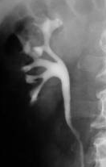
Anatomy of the collecting system and kidney stones

Slide 29
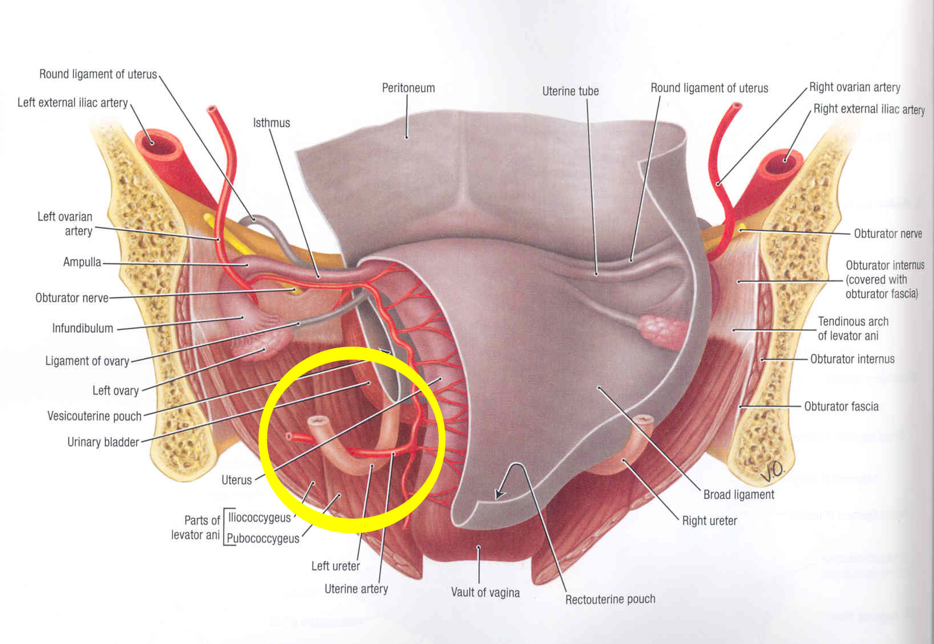
ureter X a. uterina

Slide 30
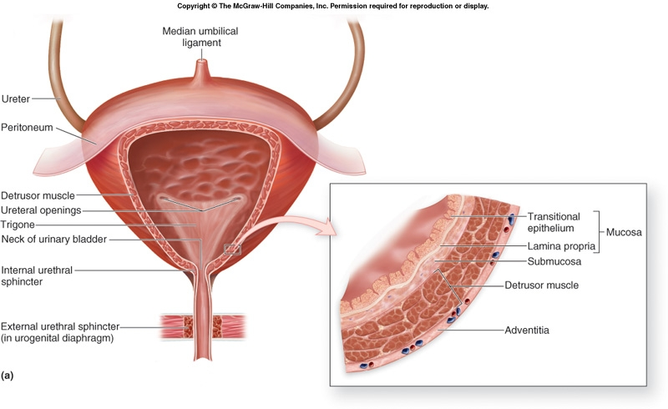
Urinary bladder

Slide 31
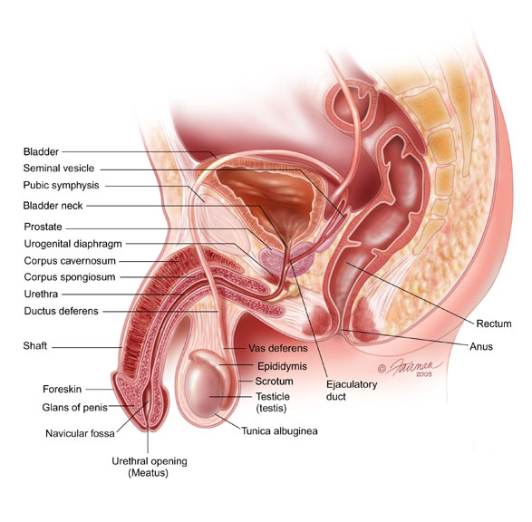
Urinary bladder
Location (Males)
- between the rectum and the pubic symphysis
- separated by rectovesical excavation
- superior to the prostate

Slide 32
Urinary bladder

Slide 33
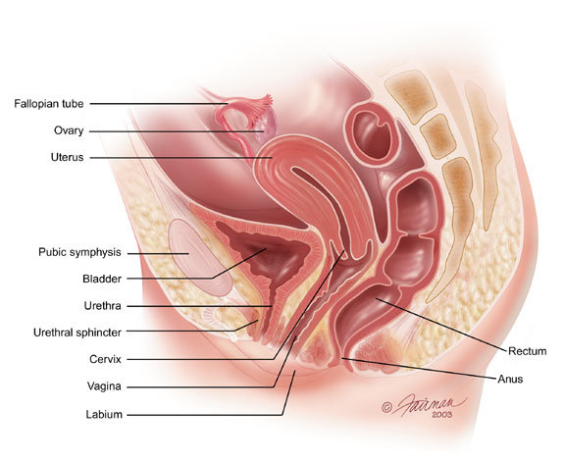
Urinary bladder
Location (Females)
inferior to the uterus
separated by vesicouterine excavation
between the vagina and the pubic symphysis

Slide 34
Urinary bladder

Slide 35
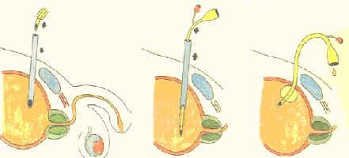
Epicystostomy

Slide 36
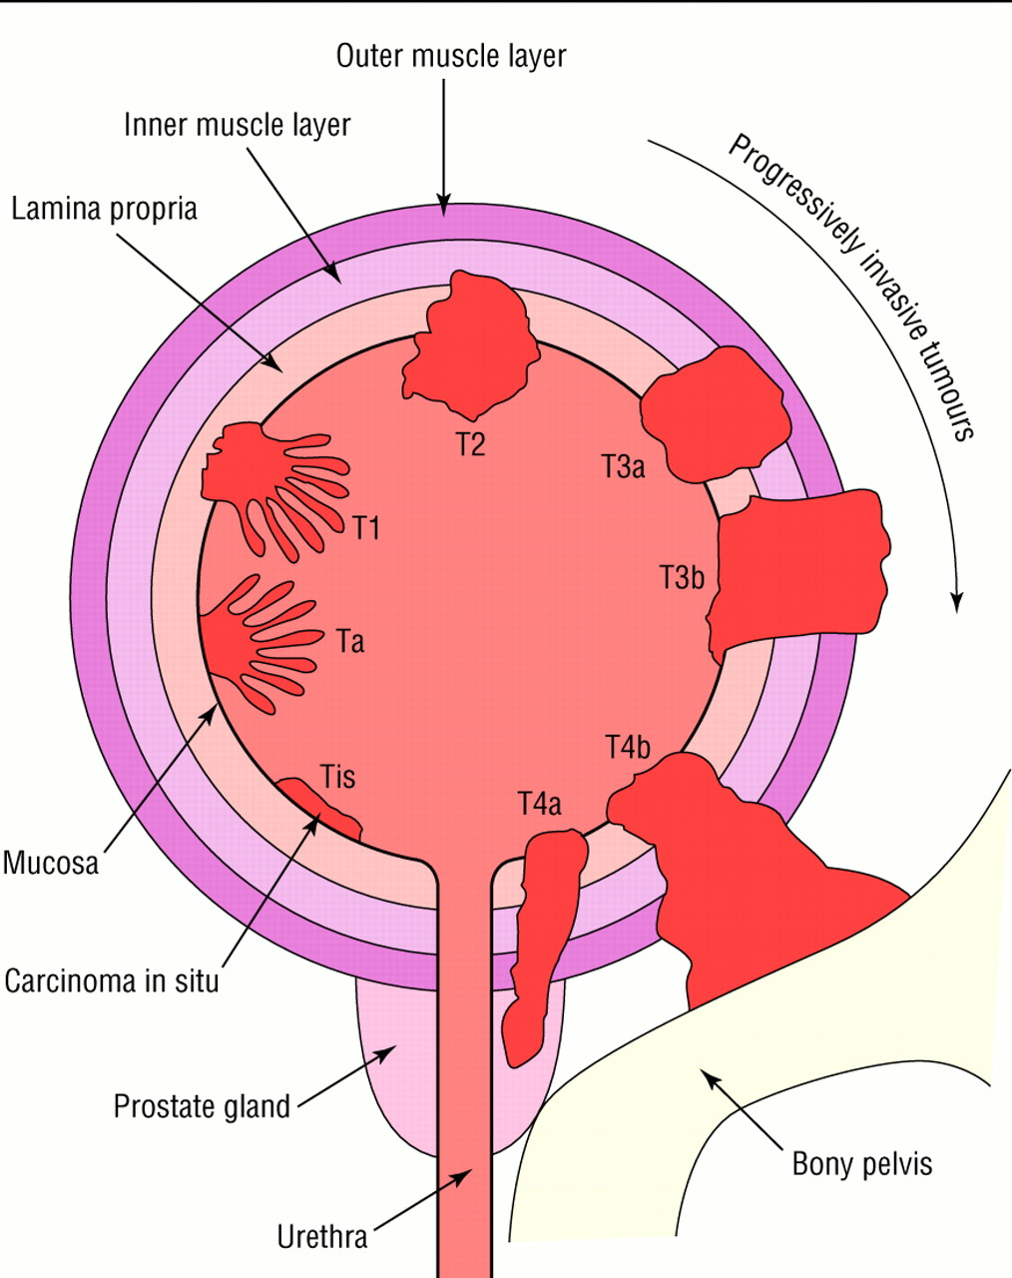
Bladder cancer - urothelial cell carcinoma
Non muscle invasive bladder cancer: pTa-pT1
Muscle invasive bladder cancer: pT2-pT4b
Carcinoma in situ

Slide 37
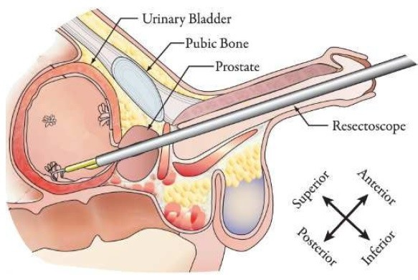
Non muscle invasive bladder cancer: pTa-pT1
Treatment: TURBT (transurethral resection)

Slide 38
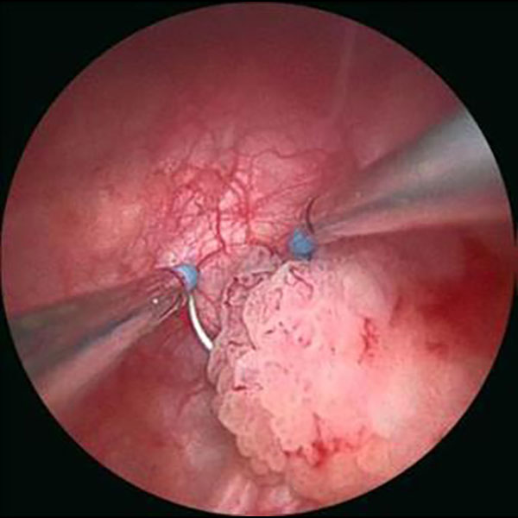
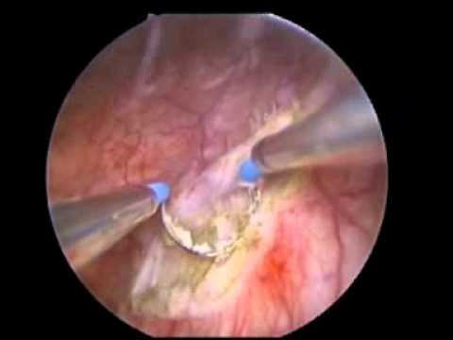
Non muscle invasive bladder cancer: pTa-pT1
Treatment: TURBT (transurethral resection)

Slide 39
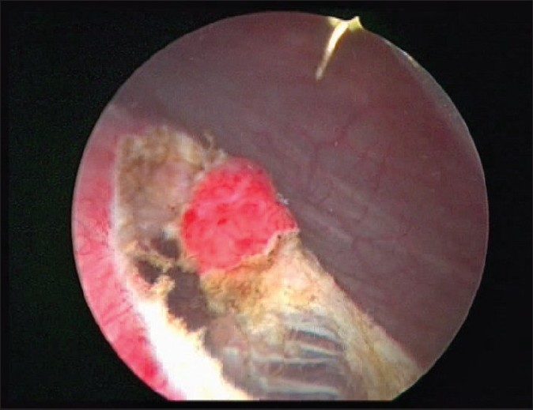
Bladder perforation

Slide 40
Muscle invasive bladder cancer: pT2-pT4b
Treatment radical cystectomy + lymphadenectomy
Men: bladder, prostate, seminal vesicles, and surrounding lymph
Women: bladder, ovaries, fallopian tube, uterus, cervix, anterior
part of the vagina, and surrounding lymph nodes
SURROUNDING LYMPH NODES ???
nodi lymphatici iliaci interni a externi

Slide 41
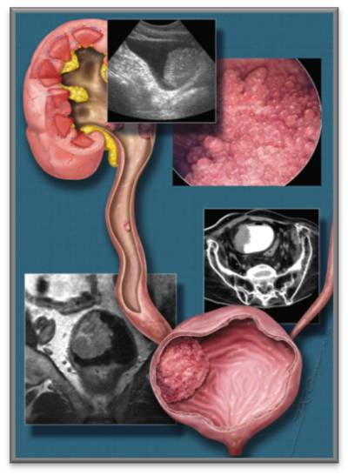
Upper urinary tract tumors
urothelial cell carcinoma 95%
diagnosis by CT urography
higher incidence in patients with
bladder tumor because of the
same epithelial lining
treatment: nephro-ureterectomy

Slide 42
Inervation and function
Inervation
Sympathetic via plexus hypogastricus inferoir (L1–L3)
m. sphincter uretrae internus
Parasympathetic via pelvic splanchnic nerves (S2–S4)
m. detrussor vesicae urinae
Sensitive (L2–S2)

Slide 43
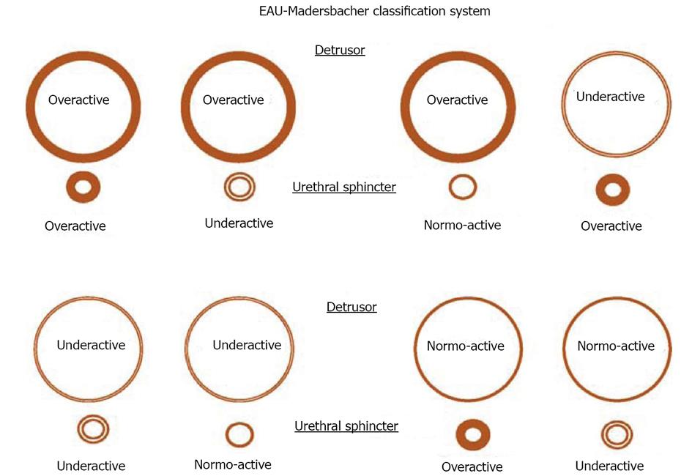

Slide 44
Treatment
Detrusor overactivity: anticholinergics, botox
Detrusor underactivity: parasympathomimetic - Distigmine
nausea, diarrhoea, vomiting, bradykardia
Sphincter overactivity: alphablockers
Sphincter underactivity: surgical treatment

Slide 45
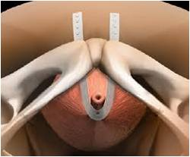
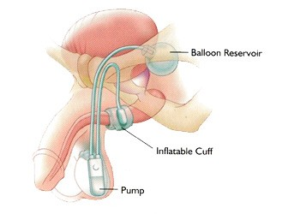
Surgical treatment of urinary incontinence

Slide 46
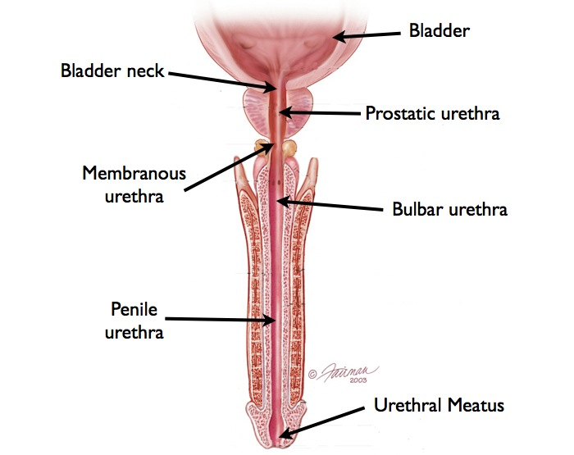
Male urethra
12-25cm
pars intramuralis
pars prostatica
pars membranacea
pars spongiosa
- bulbar
- penile

Slide 47
Male urethra
Pars intramuralis (transitional epithelium)
- preprostatic urethra
Pars prostatica (transitional)
Seminal colliculus
- ejaculatory ducts (vas deferens, seminal vesicles)
- prostatic ducts
- prostatic utricle
Pars membranacea (pseudostratified columnar)
- 1 - 2 cm
- passing through the external urethral spincter
- narrowest part of the urethra

Slide 48
Male urethra
Pars spongiosa
15–16 cm in length
Pseudostratified columnar epith. - proximally
Stratified squamous epith. - distally
through the corpus spongiosum
external urethral meatus
bulbar, penile (bulbous, pendulous)

Slide 49
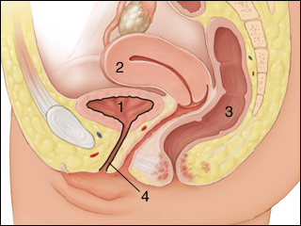
Female urethra
-4cm
slightly curved
ventraly from vagina
- Inervation: Pudendal n.
2/3 transitional epithelium
- 1/3 stratified squamous epithelium.

Slide 50
Prostate

Slide 51
Prostatic secretions
protein
simple sugars
proteolytic enzymes
prostatic acid phophatase
beta-microseminoprotein
prostate specific antigen
zinc
Fluidity of the semen, better motility of spermatozoa, longer survival, protection of the genetic material

Slide 52
Prostate - zones

Slide 53
Prostate zones
Peripheral zone (70%)
sub-capsular portion of the posterior aspect of
the prostate gland that surrounds the
distal urethra
70–80%
of prostatic cancer!!!

Slide 54
Prostate - zones
Central zone (25%)
surrounds the ejaculatory ducts
2.5% of prostate cancers although these cancers tend to be more aggressive and more likely to invade the seminal vesicles

Slide 55
Prostate - zones
Transition zone (5%)
surrounds the proximal urethra
responsible for Benign Prostatic Hyperplasia
10–20% of prostate cancers

Slide 56
Prostate - zones
Anterior fibro-muscular zone (5%)
composed only of muscle and fibrous tissue

Slide 57
Prostate - lobes
Anterior lobe
(isthmus)
Lateral lobes
Median lobe

Slide 58
TransUrethral Resection of the Prostate

Slide 59
TURP vs. Radical prostatectomy
TURP
Radical prostatectomy
benign prostate hyperplasia
endoscopic removal of transitory zone adenoma
risk of prostate cancer persists
surgical removal of the entire prostate gland, the seminal vesicles, and the vas deferens
vesicourethral anastomosis

